Slide 1
True Shape
Questions

Slide 2
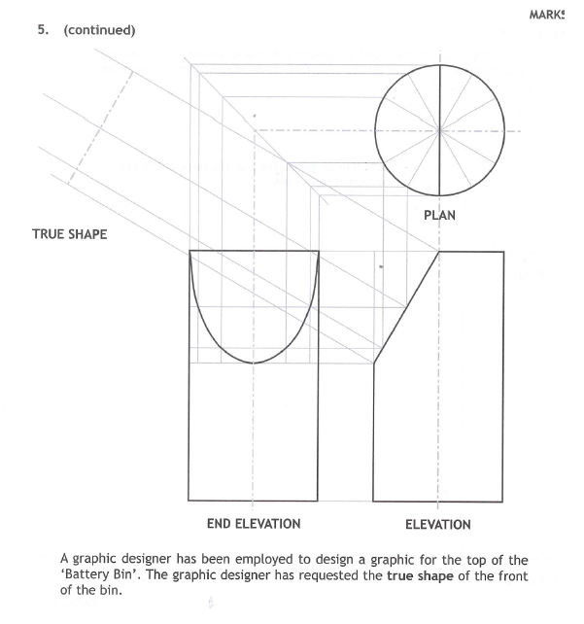

Slide 3
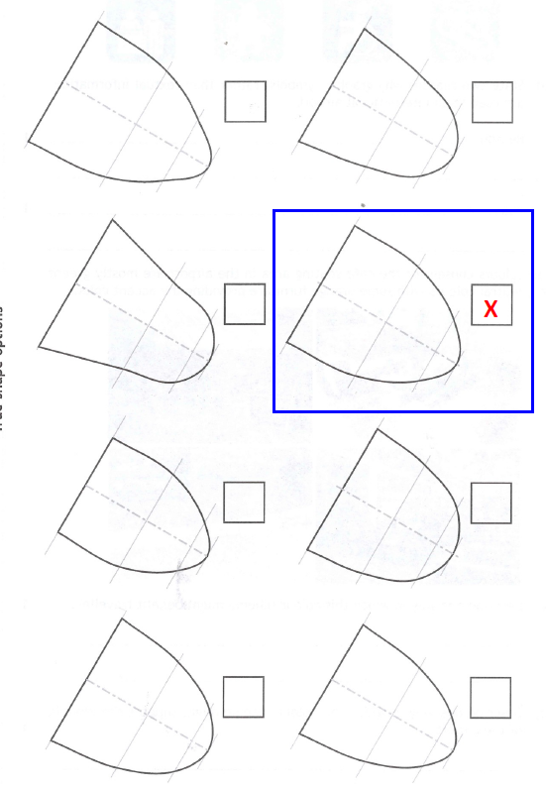

Slide 4
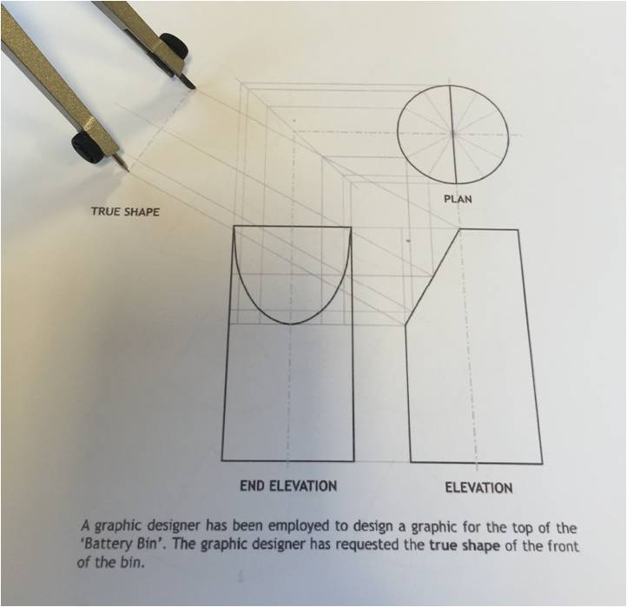
How to tackle these questions
Step 1:
Measure the length of the centre line of the true shape OR the length of the cut surface on the orthographic drawing with a compass, ruler or trammel.

Slide 5
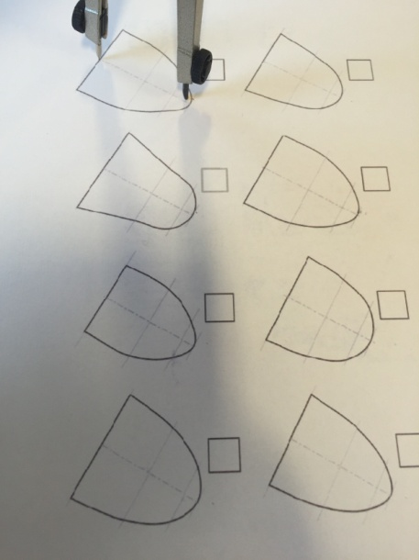
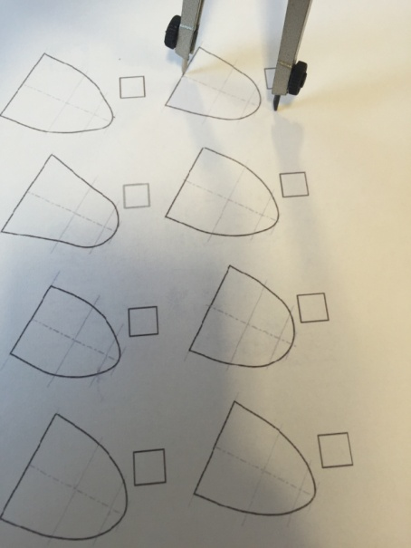
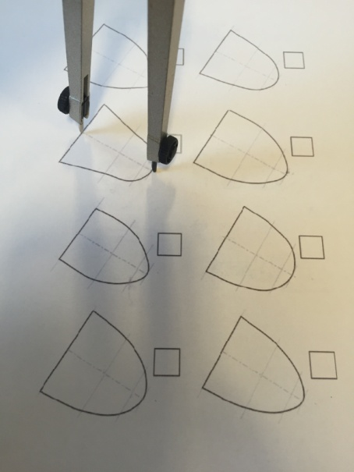
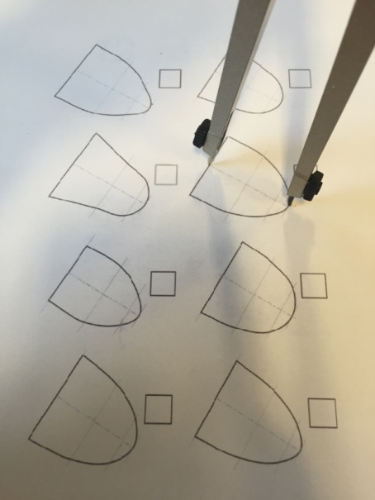
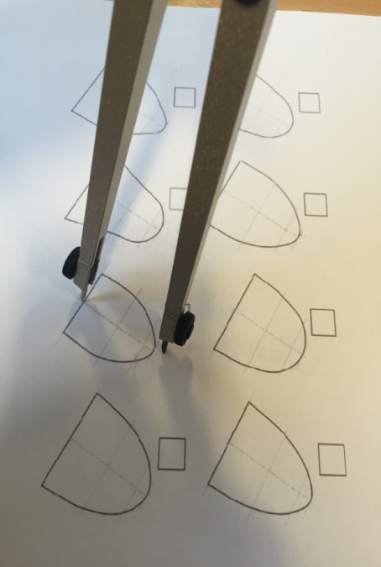
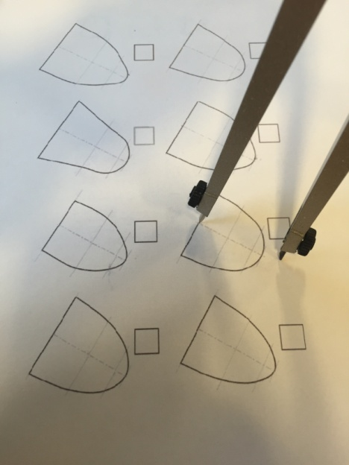
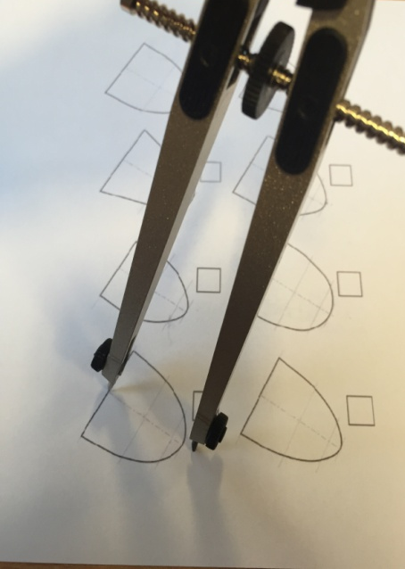
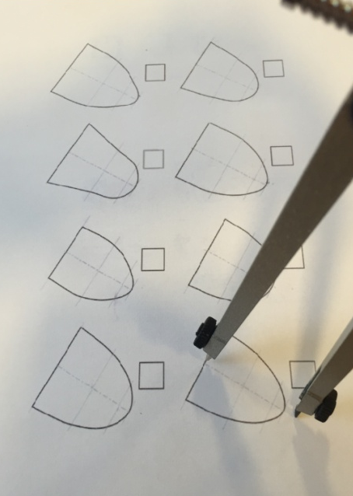
Step 2:
Compare this measurement to each of the true shapes given and cross out the ones which are too long or too short.

Slide 6
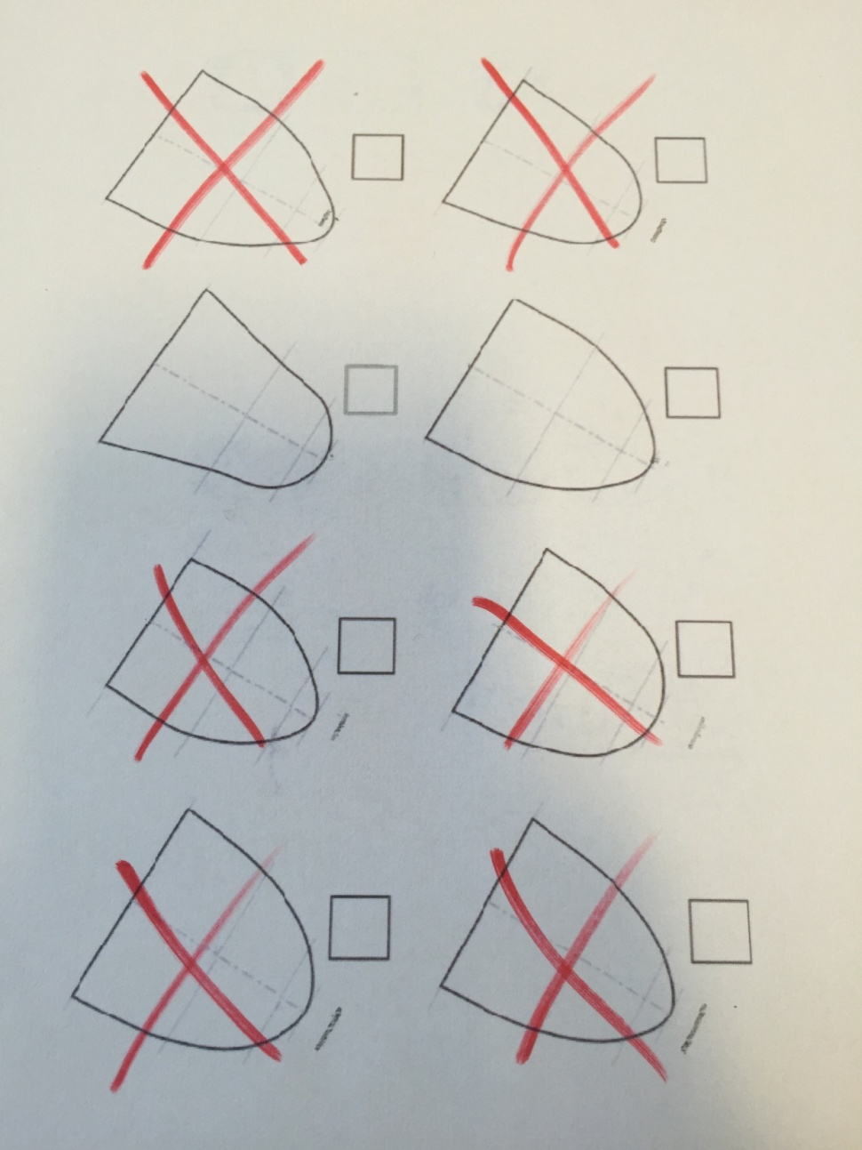
Measuring the length of the centre line has eliminated all but 2 of the true shapes.

Slide 7
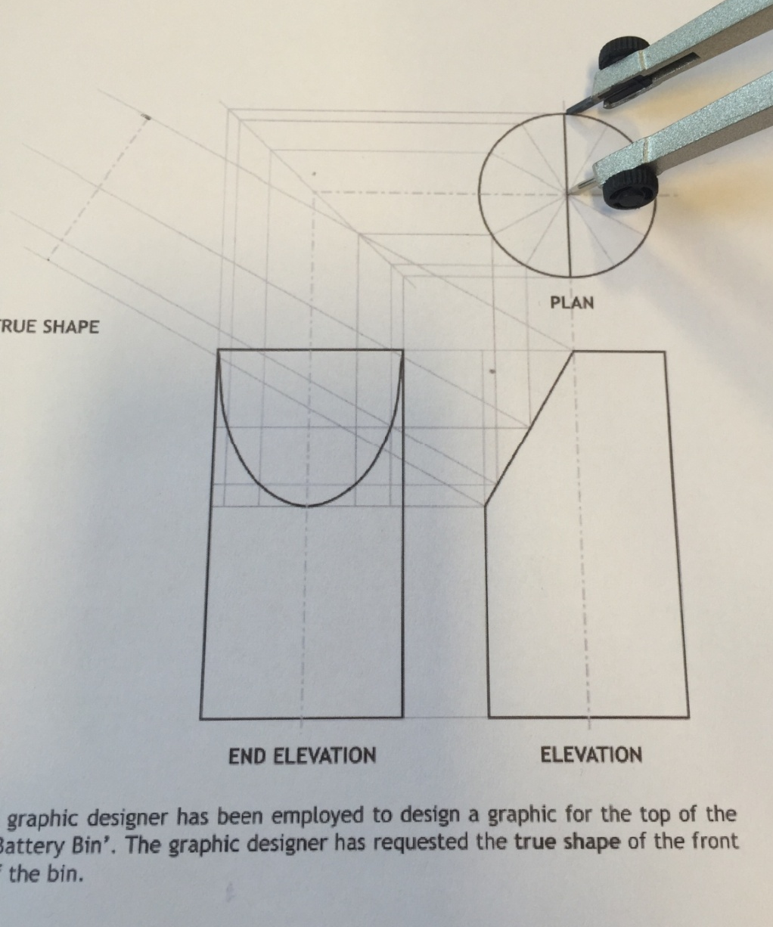
Step 3:
Measure the size of the top of the true shape by measuring the distance from the centre of the circle to the outside as shown below.

Slide 8
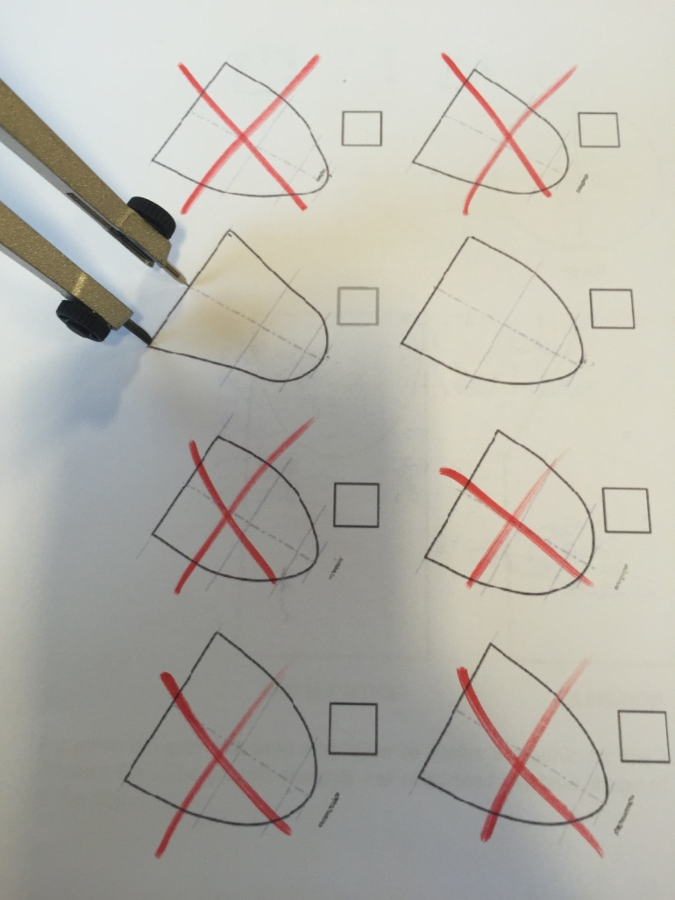
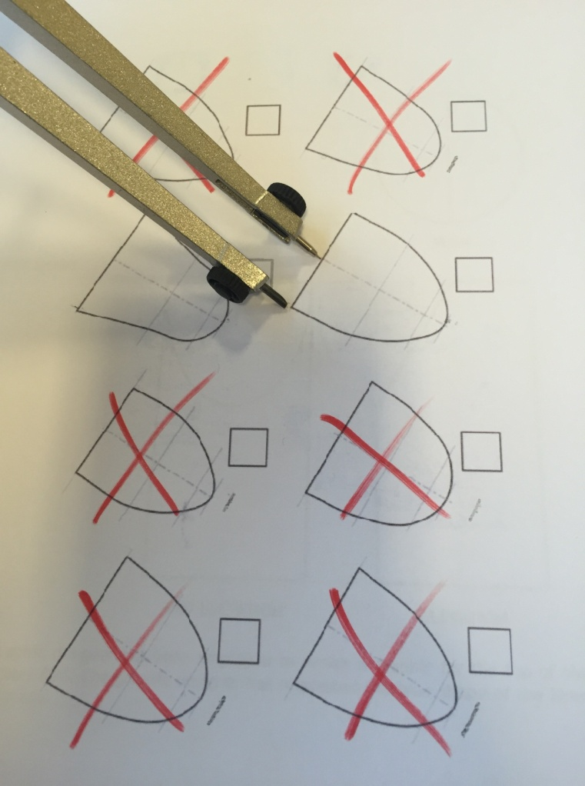
Step 4:
Compare this measurement to the two remaining true shapes.
As you can see, this did not help us to eliminate either of them so we must take another measurement.

Slide 9
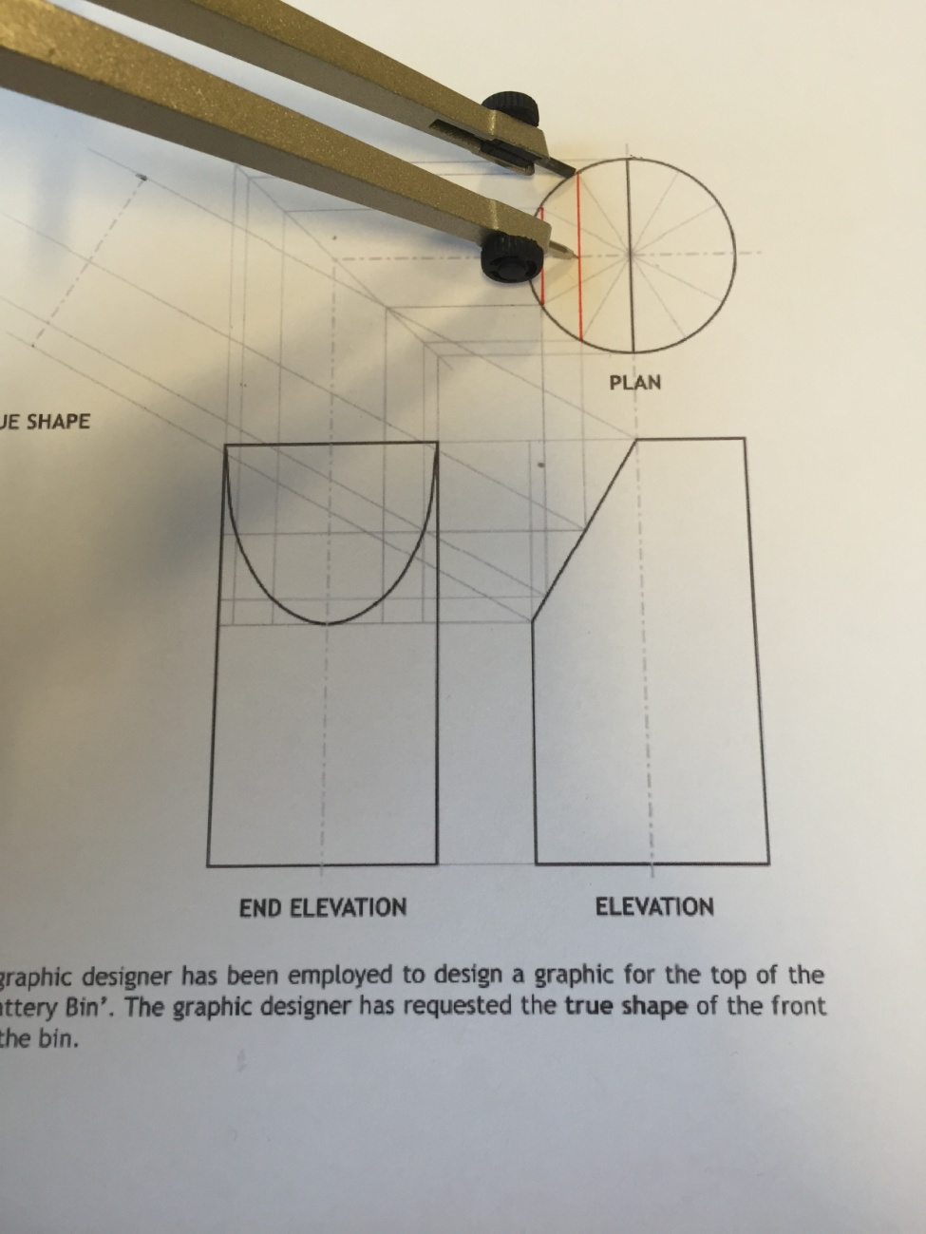
Step 5:
Measure the next width on the plan as shown below and compare this to the true shapes.

Slide 10
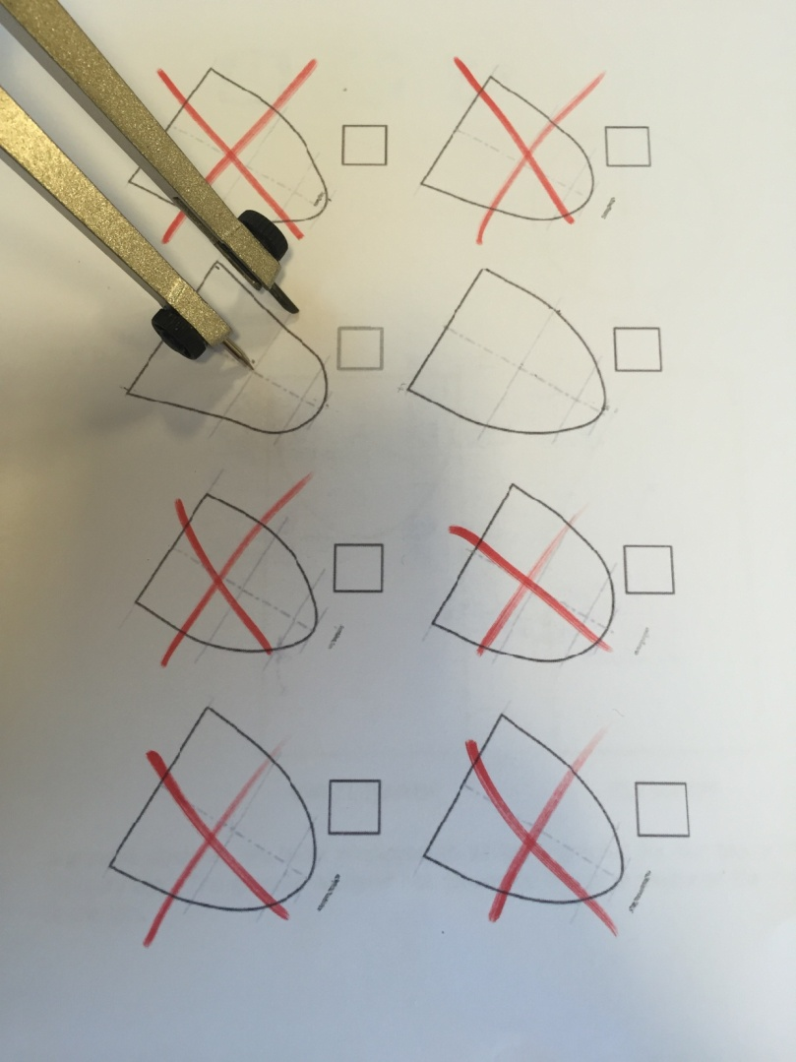
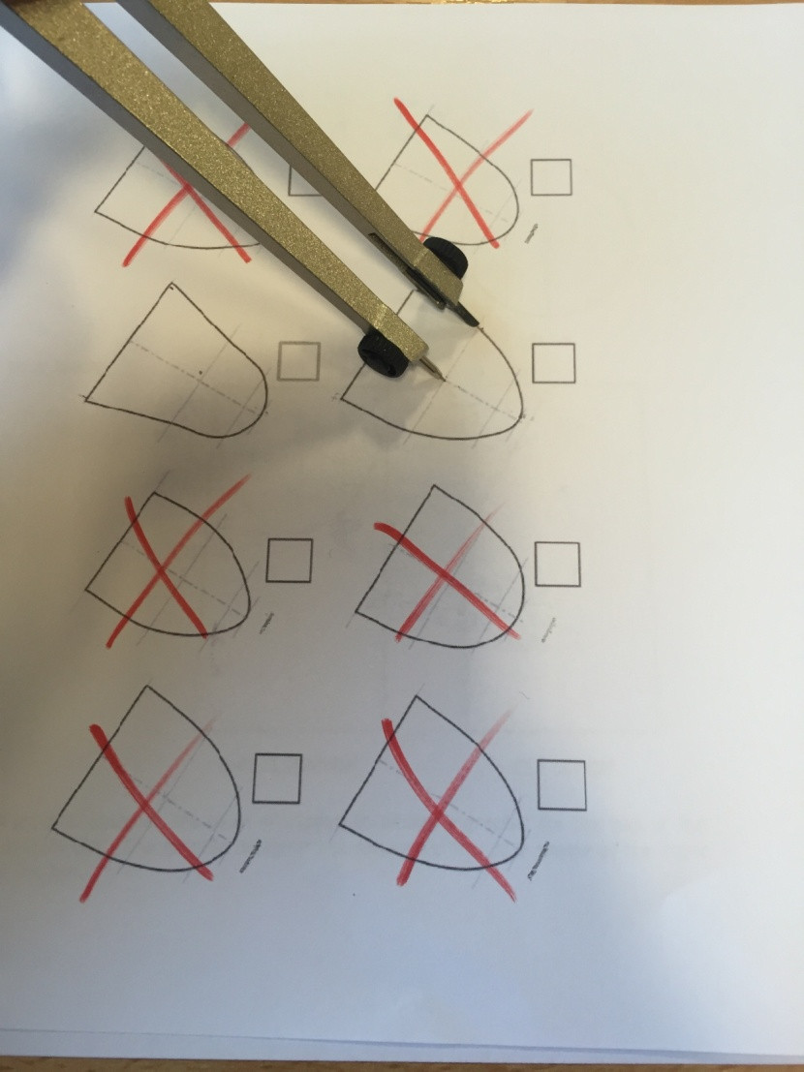
As you can see, comparing this measurement has allowed us to eliminate the true shape on the left leaving us with the correct answer.

Slide 11
