Slide 1
S1/2 Graphic Communication
Tasks
Name:
Class:

Slide 2
About this booklet
This booklet contains the tasks that you should complete alongside reading through the presentation you have been supplied with. You can either print this booklet on A4 paper to complete by hand, or you can edit this power point to complete tasks, or grab some A4 paper, copy the drawings and complete them that way.
Learning Intentions:
You will have a basic knowledge of how to use the rule of thirds
You will understand what flashbars are and how they enhance a design
You will have a basic knowledge of colour theory, including the colour wheel and how to effectively use harmonising and contrasting colours
You will understand what design principles are and be able to create two of the more easily understood principle, depth and dominance
Success Criteria:
You will be able to identify the rule of thirds in existing advertisements
You will be able to place a flashbar in an existing design
You will be able to complete a colour wheel and answer questions regarding primary, secondary and tertiary colours
You will understand what design principles are and be able to create two of the more easily understood principle, depth and dominance
Benchmarks:
TCH 2-11a - I can use a range of graphic techniques, manually and digitally, to communicate ideas, concepts or products, experimenting with the use of shape, colour and texture to enhance my work.

Slide 3
Task 1 – rule of thirds
Find a poster/advert either in a magazine you have at home, or find one on the internet that you believe displays the rule of Thursday. They, either on the computer or by hand, draw the four lines that divide the page and draw the circles on the impact points, were you right? How could you change the advert to improve it?
Examples:
Impact Points

Slide 4
Slide for answer

Slide 5
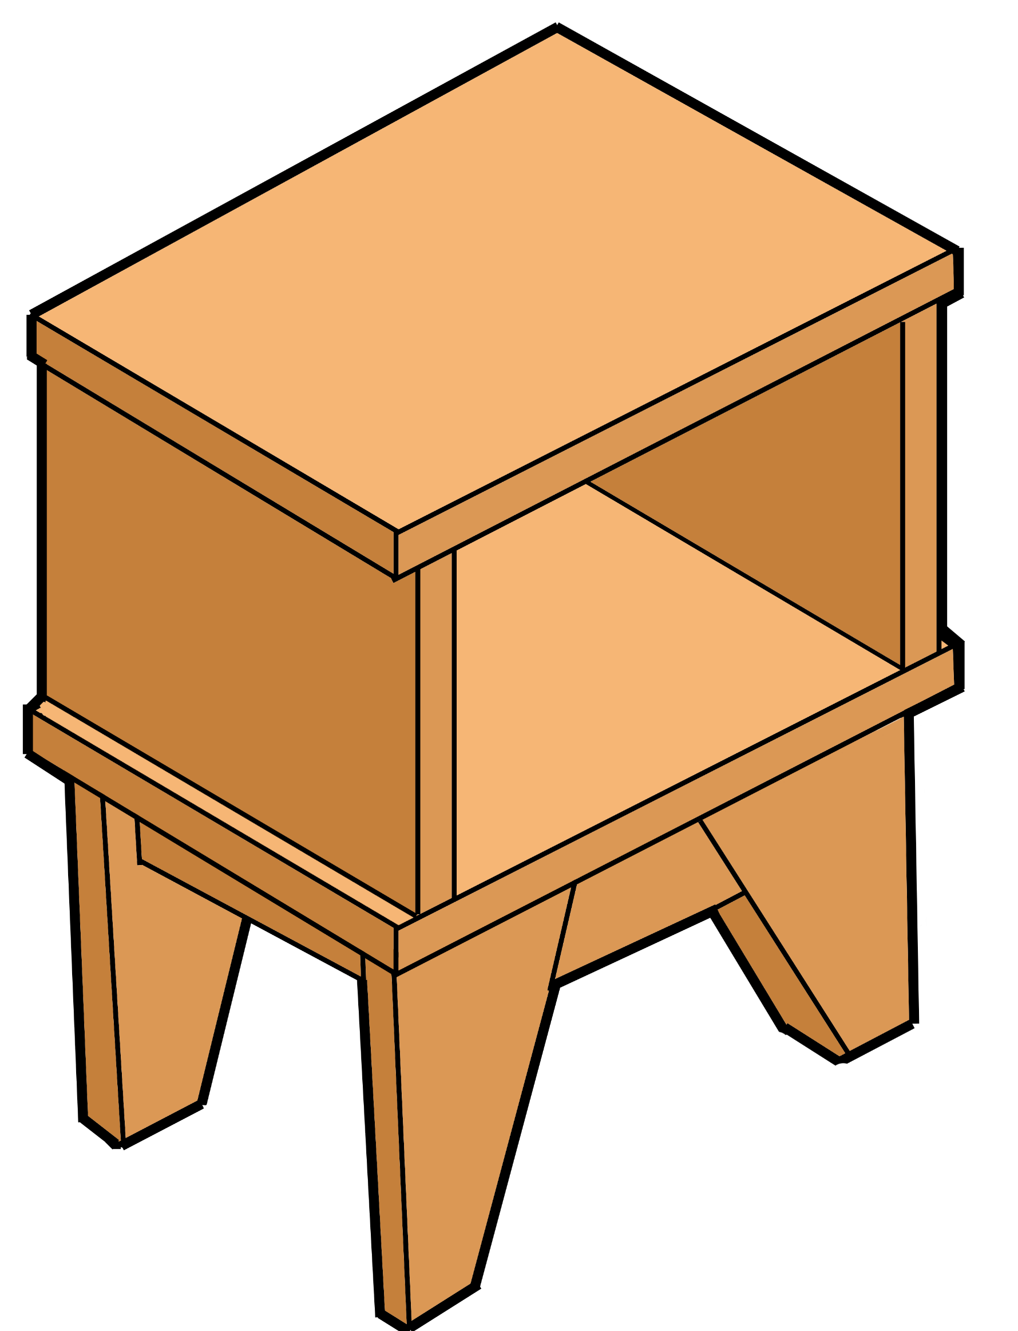
Task 2 - Flashbars
Add a flashbar to the poster. This flashbar should be used to add depth and make the main product (the table) stand out against the background!
(If you are completing this on paper, then redraw the whole poster)
Book Table
ajhsdkjahsdkjajhsdkjahsdkj
ajhsdkjahsdkjajhsdkjahsdkj
ajhsdkjahsdkjajhsdkjahsdkj
ajhsdkjahsdkjajhsdkjahsdkj
ajhsdkjahsdkjajhsdkjahsdkj

Slide 6
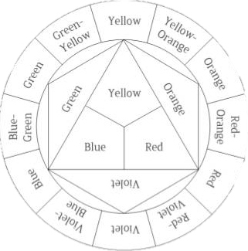
Task 3 – Colour Wheel
Colour the colour wheel (mix colours to complete the tertiary colours)
Answer the following questions:
What are the three primary colours?
How is a secondary colour made?
How is a tertiary colour made?
Name a warm colour
Name a cool colour

Slide 7
Task 4 – Harmony and contrast
a) Complete the following questions
What effect does using contrasting colours make?
________________________________________________________________________________________________________________________________________________
What effect does using harmonising colours make?
________________________________________________________________________________________________________________________________________________
a) Finish the following sentences with the names of colours
__________ contrasts with ___________
__________ contrasts with ___________
__________ contrasts with ___________
__________ harmonises with __________
__________ harmonises with __________
__________ harmonises with __________

Slide 8
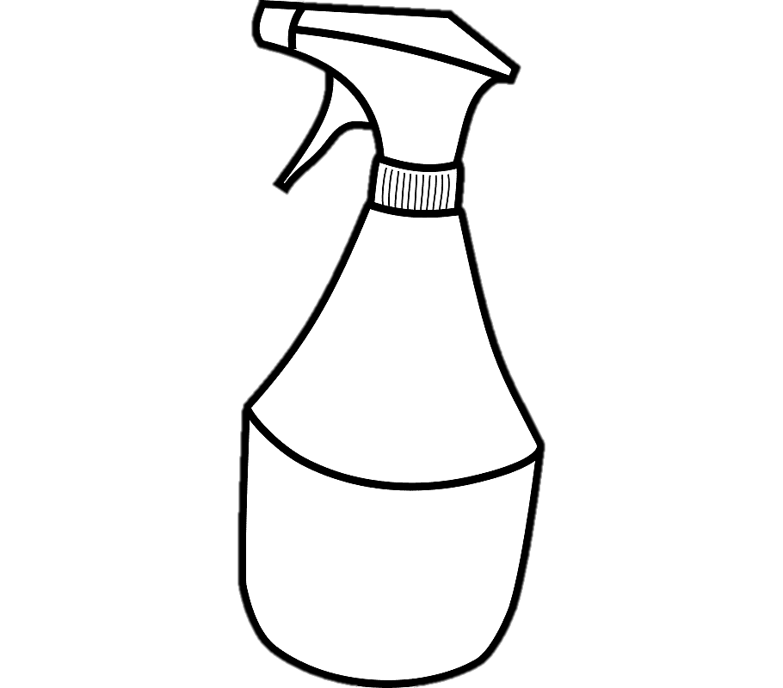
Task 5 – Harmony and Contrast
The two images show a product and a flash bar, your task is to colour A using only harmonising colours and B using contrasting colours, what effect does it create?
A)
B)

Slide 9
Task 6 - Depth
Find an example of a poster/advertisement/image that has depth. You can find this advert in magazines, online, or you can sketch one yourself! Add annotation to the advert so show how they have added depth.
Example:
Drop-shadow added to title and main image of product
Book Table
Drop-shadow added to title and main image of product
Elements of the layout overlap, making it look as though some are closer than others
Used 3D image of product
Dfjhksjfh akshkjdfh fkjahdsk askdjhasdf ajkhadfam sdkjhaf ajfbmn asfdja dkjasnd kjhad jhaf jamn kjfmns djabsdm fkjasdmfn
Store your books in style!

Slide 10
Slide for answer

Slide 11
Task 7
It’s time to take everything that you have learned and bring it all together!
Your final and largest task is to find a product in your home (this could be your games console, your kettle or even a table and create an A4 advert for the product that could be in a magazine. It is up to you whether this advertisement is portrait or landscape but it must include the following things:
A title
An image of the product (either a photo or a sketch)
A box of text that describes the product
A flash-bar
Your advert must also make use of contrast, depth and dominance

