Slide 1
S1/2 Graphic Communication
Notes

Slide 2
Graphic Communication
This booklet is designed to give you an introduction to Desktop Publishing and by the end of it you will be able to produce one complete advertisement for a product of your choosing:
Learning Intentions:
You will have a basic knowledge of how to use the rule of thirds
You will understand what flashbars are and how they enhance a design
You will have a basic knowledge of colour theory, including the colour wheel and how to effectively use harmonising and contrasting colours
You will understand what design principles are and be able to create two of the more easily understood principle, depth and dominance
Success Criteria:
You will be able to identify the rule of thirds in existing advertisements
You will be able to place a flashbar in an existing design
You will be able to complete a colour wheel and answer questions regarding primary, secondary and tertiary colours
You will understand what design principles are and be able to create two of the more easily understood principle, depth and dominance
Benchmarks:
TCH 2-11a - I can use a range of graphic techniques, manually and digitally, to communicate ideas, concepts or products, experimenting with the use of shape, colour and texture to enhance my work.

Slide 3
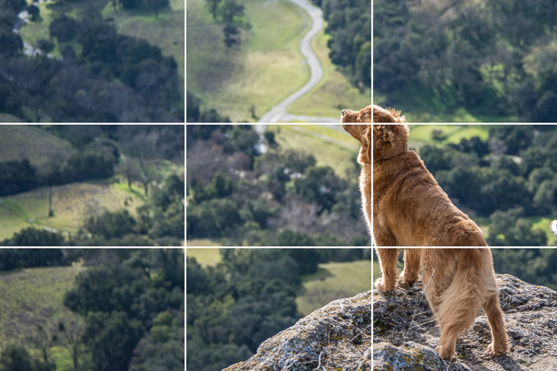
Rule of Thirds
When a layout space is divided into nine equal rectangles, four lines dividing the space provide focal points. Placing important features on or close to a line can create a more visually pleasing layout.
Impact points, where the lines cross, are key areas to locate important features.

Slide 4
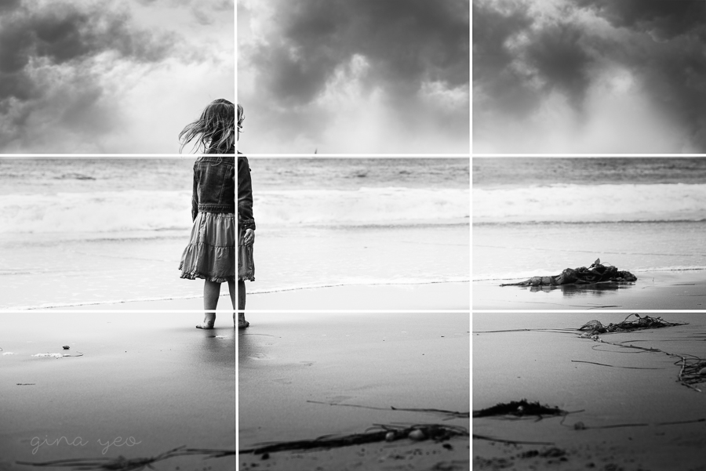

Slide 5
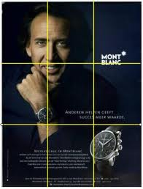

Slide 6
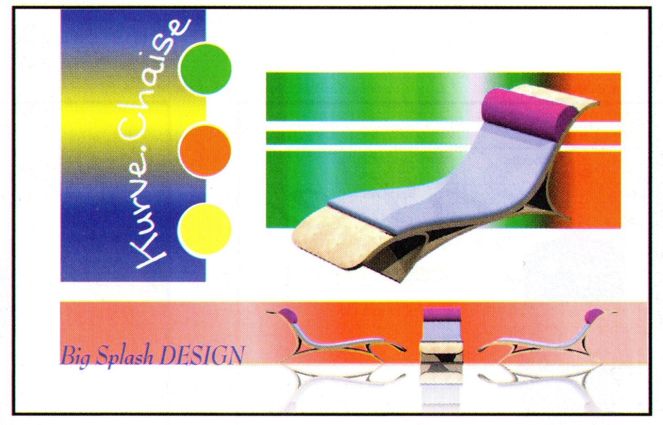
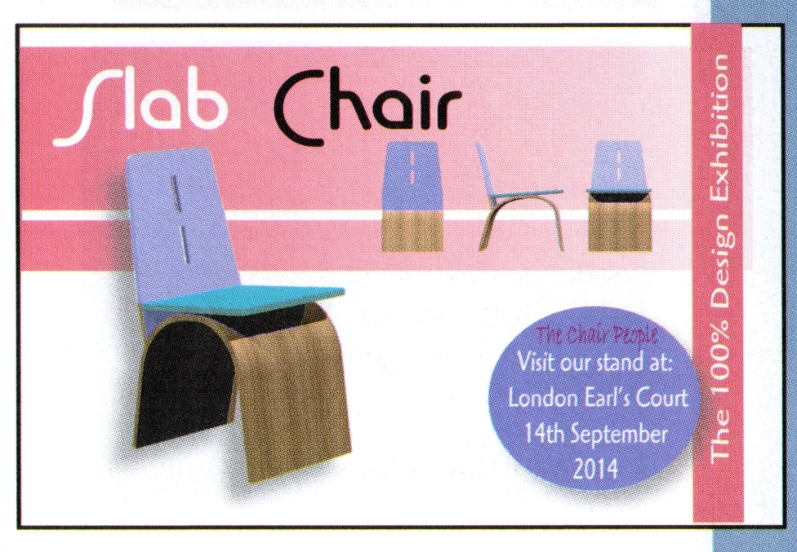
FLASHBARS
Flash bars are bars or shapes of colour that act as a great way to make the main product stand out, either by adding contrast or depth. They are also very effective at drawing your eyes across the page to the final product.

Slide 7
Flash-bars are not always obvious, these red ones draw your eyes across the page and add contrast in colour!

Slide 8
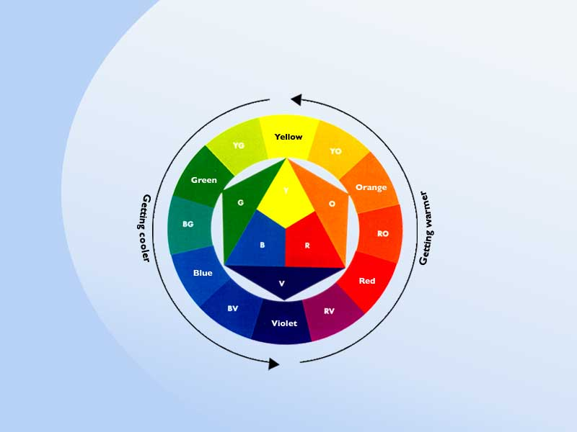
Colour Theory – The Colour Wheel
You can greatly enhance any graphic or sketch with the careful addition of colour. There are more rules than you might think regards what colours should be used when. You will get to know what the main rules are by studying the following couple of pages.
We will start by talking about the colour wheel and it’s three main sections, PRIMARY, SECONDARY and TERTIARY colours

Slide 9
Colour Theory – Primary colours
These are the basic three colours from which every other colour can be made, they include:
Yellow
Red
Blue

Slide 10
Colour Theory – Secondary colours
Scondary colours are created from mixing two of the primary colours, the include:
Orange – Made from mixing red and yellow
Green – Made from mixing yellow and blue
Violet – Made from mixing red and blue

Slide 11
Colour Theory – Tertiary colours
Tertiary colours are made by mixing a primary colour with a secondary colour.
There are many teriary colours, including yellow-orange, red-orange, red-violet, blue-violet, blue-green and yellow-orange.

Slide 12
Colour Theory – Shades and tints
Shades
A shade is made when you mix a basic colour with black.
Tints
A tint is made when you mix a basic colour with white.
Shade
Tint

Slide 13
Design Principles
Design principles are a set of rules that can be used to improve designs and layouts or convey a specific effect, such as making a particular object or word stand out, make the layout exciting or make sure that the eye is drawn across the page. There are a number of principles, however we will only focus on the following:
Dominance
Depth
Contrast
Harmony

Slide 14
Contrast and Harmony
Contrasting Colours
Contrasting colours are on opposite sides of the colour wheel.
Harmonising Colours
Harmonising colours are close to each other on the colour wheel.

Slide 15
Contrast and Harmony in design
Contrast
Contrast is vibrant, eye catching, bold and exciting (eg blue and orange)
Harmony
Harmony is easy on the eye and can be used to create a relaxed and elegant ambiance (eg blue and blue-green).

Slide 16
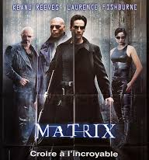
Harmony

Slide 17
Contrast

Slide 18
Design Principles - Dominance
Dominance is created by taking one part of the layout (usually an image of the product, or the name of the product) and making it the most dominant thing on the page by increasing the size, or making other parts of the page smaller. You can also do this by changing the colours to create contrast.

Slide 19
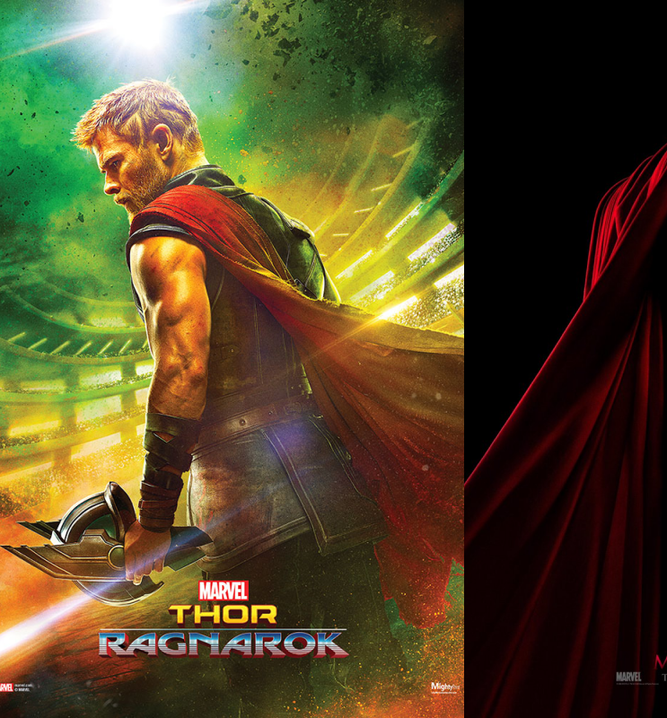
Dominance

Slide 20
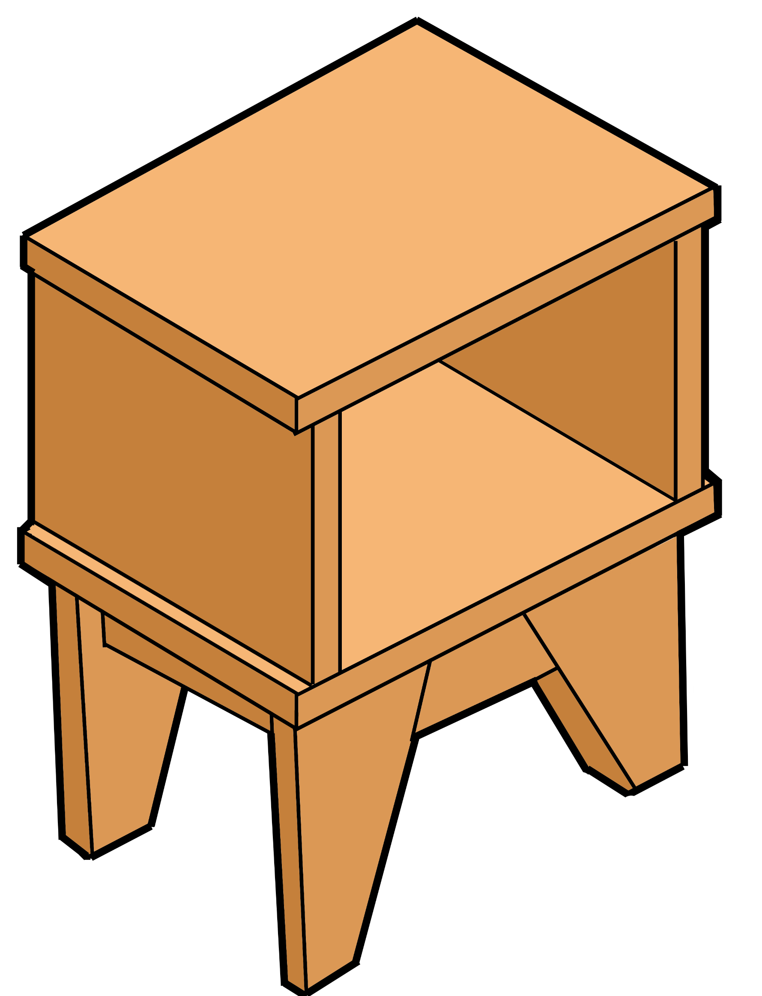
Design Principles - Depth
Depth occurs when you make a 2D display appear to be 3D by making some parts of the layout appear closer to the reader than others. This can be created by:
Adding drop-shadows to elements of the page
Making an image or title partially cover another element
Add a flash bar behind the main image
Use transparency
Book Table
Dfjhksjfh akshkjdfh fkjahdsk askdjhasdf ajkhadfam sdkjhaf ajfbmn asfdja dkjasnd kjhad jhaf jamn kjfmns djabsdm fkjasdmfn kjasf kjabfs akfjbmasn jasdm asdkjbd afkjbdn adkja
Store your books in style!

Slide 21
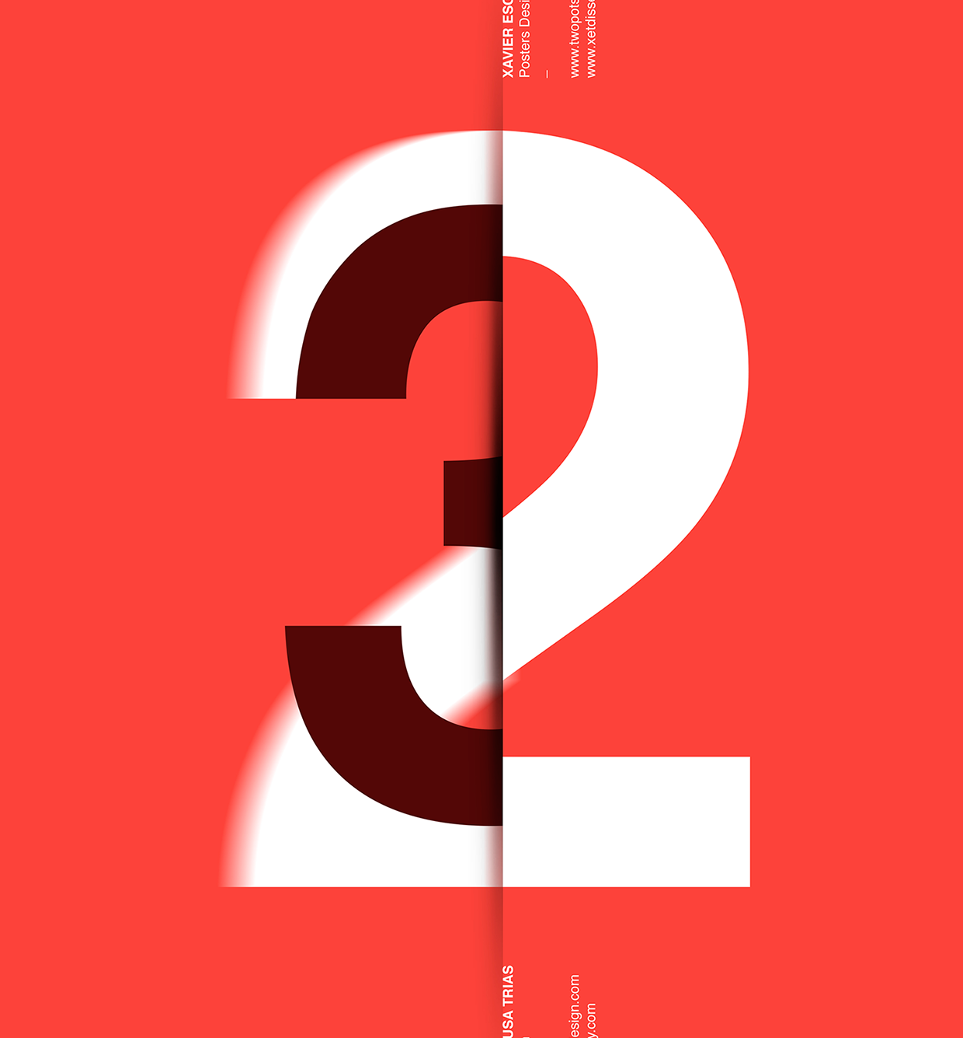
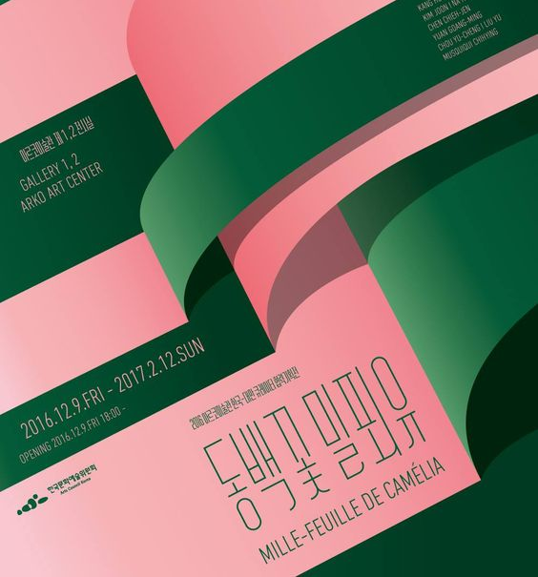
Depth

