Slide 1
Wave Characteristics
Learning Intentions:
To state what a wave is.
To be able to label the components of a wave.

Slide 2
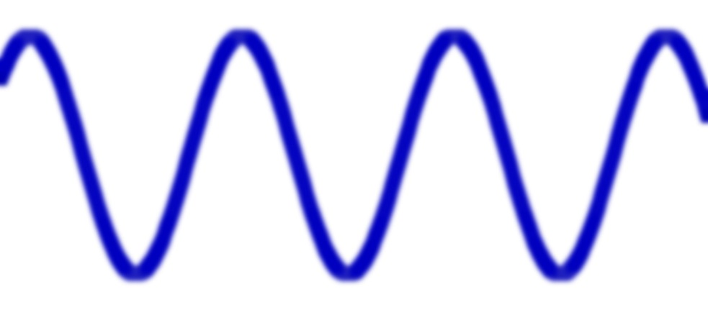
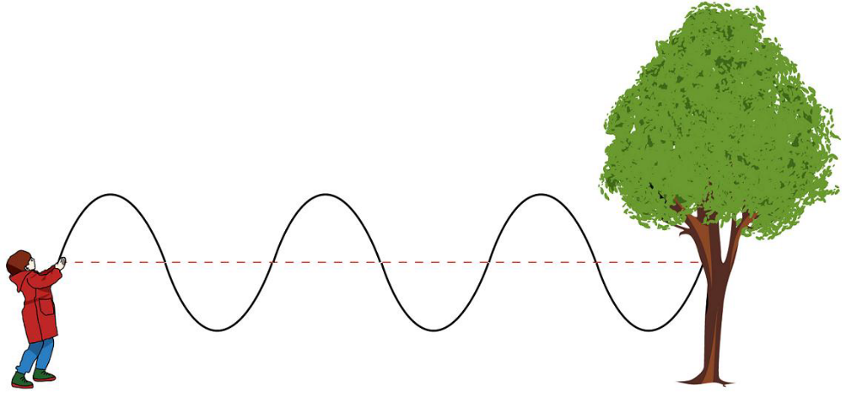
What is a wave?
A wave transfers energy from one place to another.
Waves are made from particles vibrating.
Photons, electrons and elemental particles all behave like particles AND waves

Slide 3
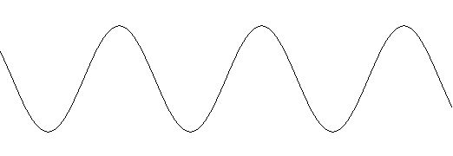
Water Waves
If you were in a swimming pool and they turned on the wave machine, the waves make you move up and down (bob) rather than pushing you along!
The top of a wave is a peak, the bottom is a trough
Peak
Direction of vibration of particles.
Trough
Direction of wave

Slide 4
Wavelength
Wavelength is the distance from one point on a wave to the same point on the next wave (peak to peak, trough to trough
The unit of measurement is metres (m)
The symbol for wavelength is λ

Slide 5
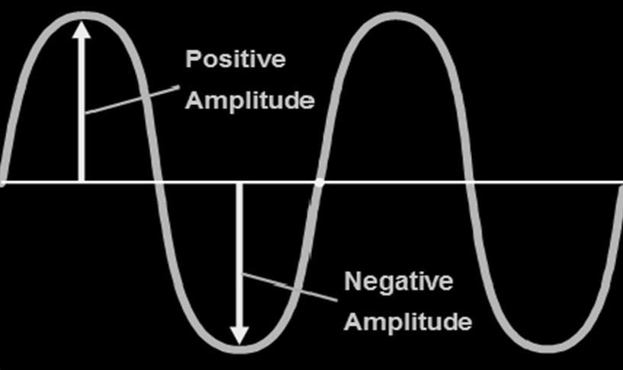
Amplitude
Amplitude size is how much energy a wave has
It is measured by distance from central axis to a crest or trough
The unit of measurement is metres (m)

Slide 6
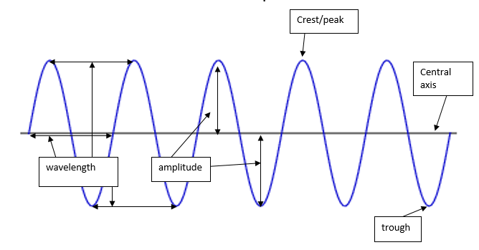
Components of a Wave
Frequency, f – is the number of waves that pass a point each second. It’s measured in Hertz (Hz)

Slide 7
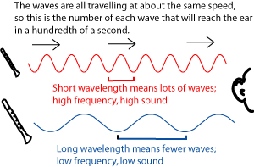
Physical Applications
Loud notes have more energy than quiet notes and therefore have a larger amplitude.
High pitch notes produce more waves per second and therefore have a higher frequency.

Slide 8
Pit of Learning:
Stages 1, 2, 3, 4, and 5
At the end of every lesson we will do ‘Fist to 5’ to determine where we are in the pit!

Slide 9
Learning Intentions – Learning Pit:
To give an example of transverse and longitudinal wave.
To be able to label the components of a wave.

Slide 10
Exit Pass
Fill in an exit pass and stick it to our tree of knowledge. Write down:
What is the wavelength of a wave.
Then pack up and stand behind your chairs to be dismissed in order.

