Slide 1
Welcome
Supporting Mental Wellbeing – Parent Zoom Event
Harry Prescott
PT Pastoral Care
Natalie Miller
Family Liaison Officer
FARE

Slide 2
Outline
How to support your young person
What to say at home
Support Services
Mental Health Ambassadors
Minds Matter
Clare from Children’s First
Q + A

Slide 3
How to Support your Young Person
Routine
Sleeping Pattern
Diet
Meal Times
Structure
School Day
Homework
Accountability- sorting bag etc
Purposeful Activity
Clubs (school or external)
Tasks at home
Responsibility

Slide 4
How to Support your Young Person
5 steps to wellbeing
Connect with other people
Be physically active
Learn new skills
Give to others
Pay attention to present moment
NHS website

Slide 5
How to Support your Young Person

Slide 6
What to say at home
Listen first
Reassure and understand
Look out for signs (eating, poor routine, hygiene)
Ask – are you struggling? Are you okay?
Time with young person
Alternative communication
Environment

Slide 7
Support Services
There are so many! Some are:
Breathing space (NHS-16+) (0800 83 85 87)
Childline (0800 1111)
Young Person’s Compassionate Response Service (16+) (distressed young person)
Glasgow City Council Youth Service (12-19) (0141 451 2727)
Parentline (08000 28 22 33)

Slide 8
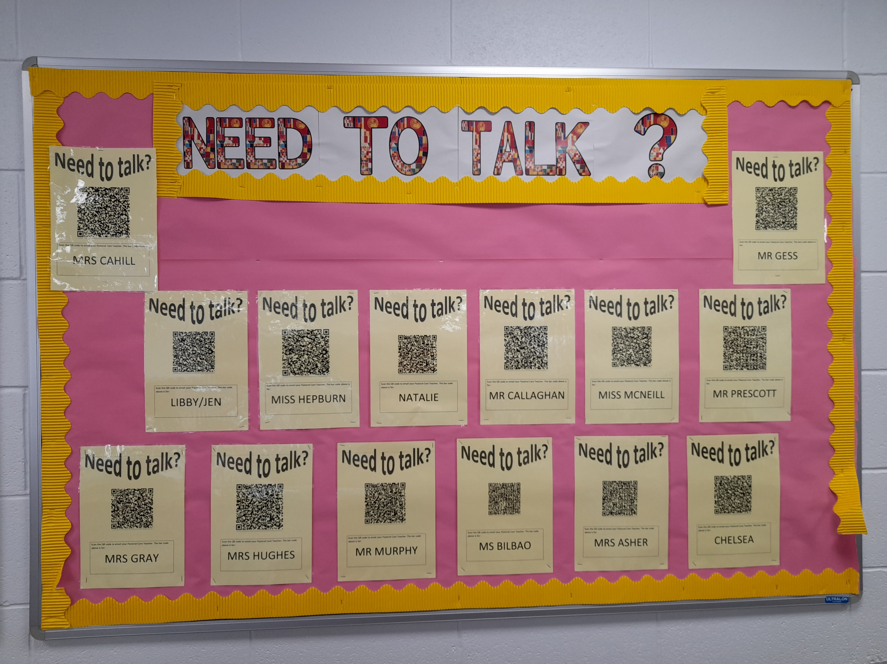
Support Services in School
Pastoral Care
FARE and J12 (Youth Base)
Minds Matter
QR Codes
School Counsellor (Referral made by PC)
Mental Health Ambassadors
PSE
MCR Pathways
School Mentors

Slide 9
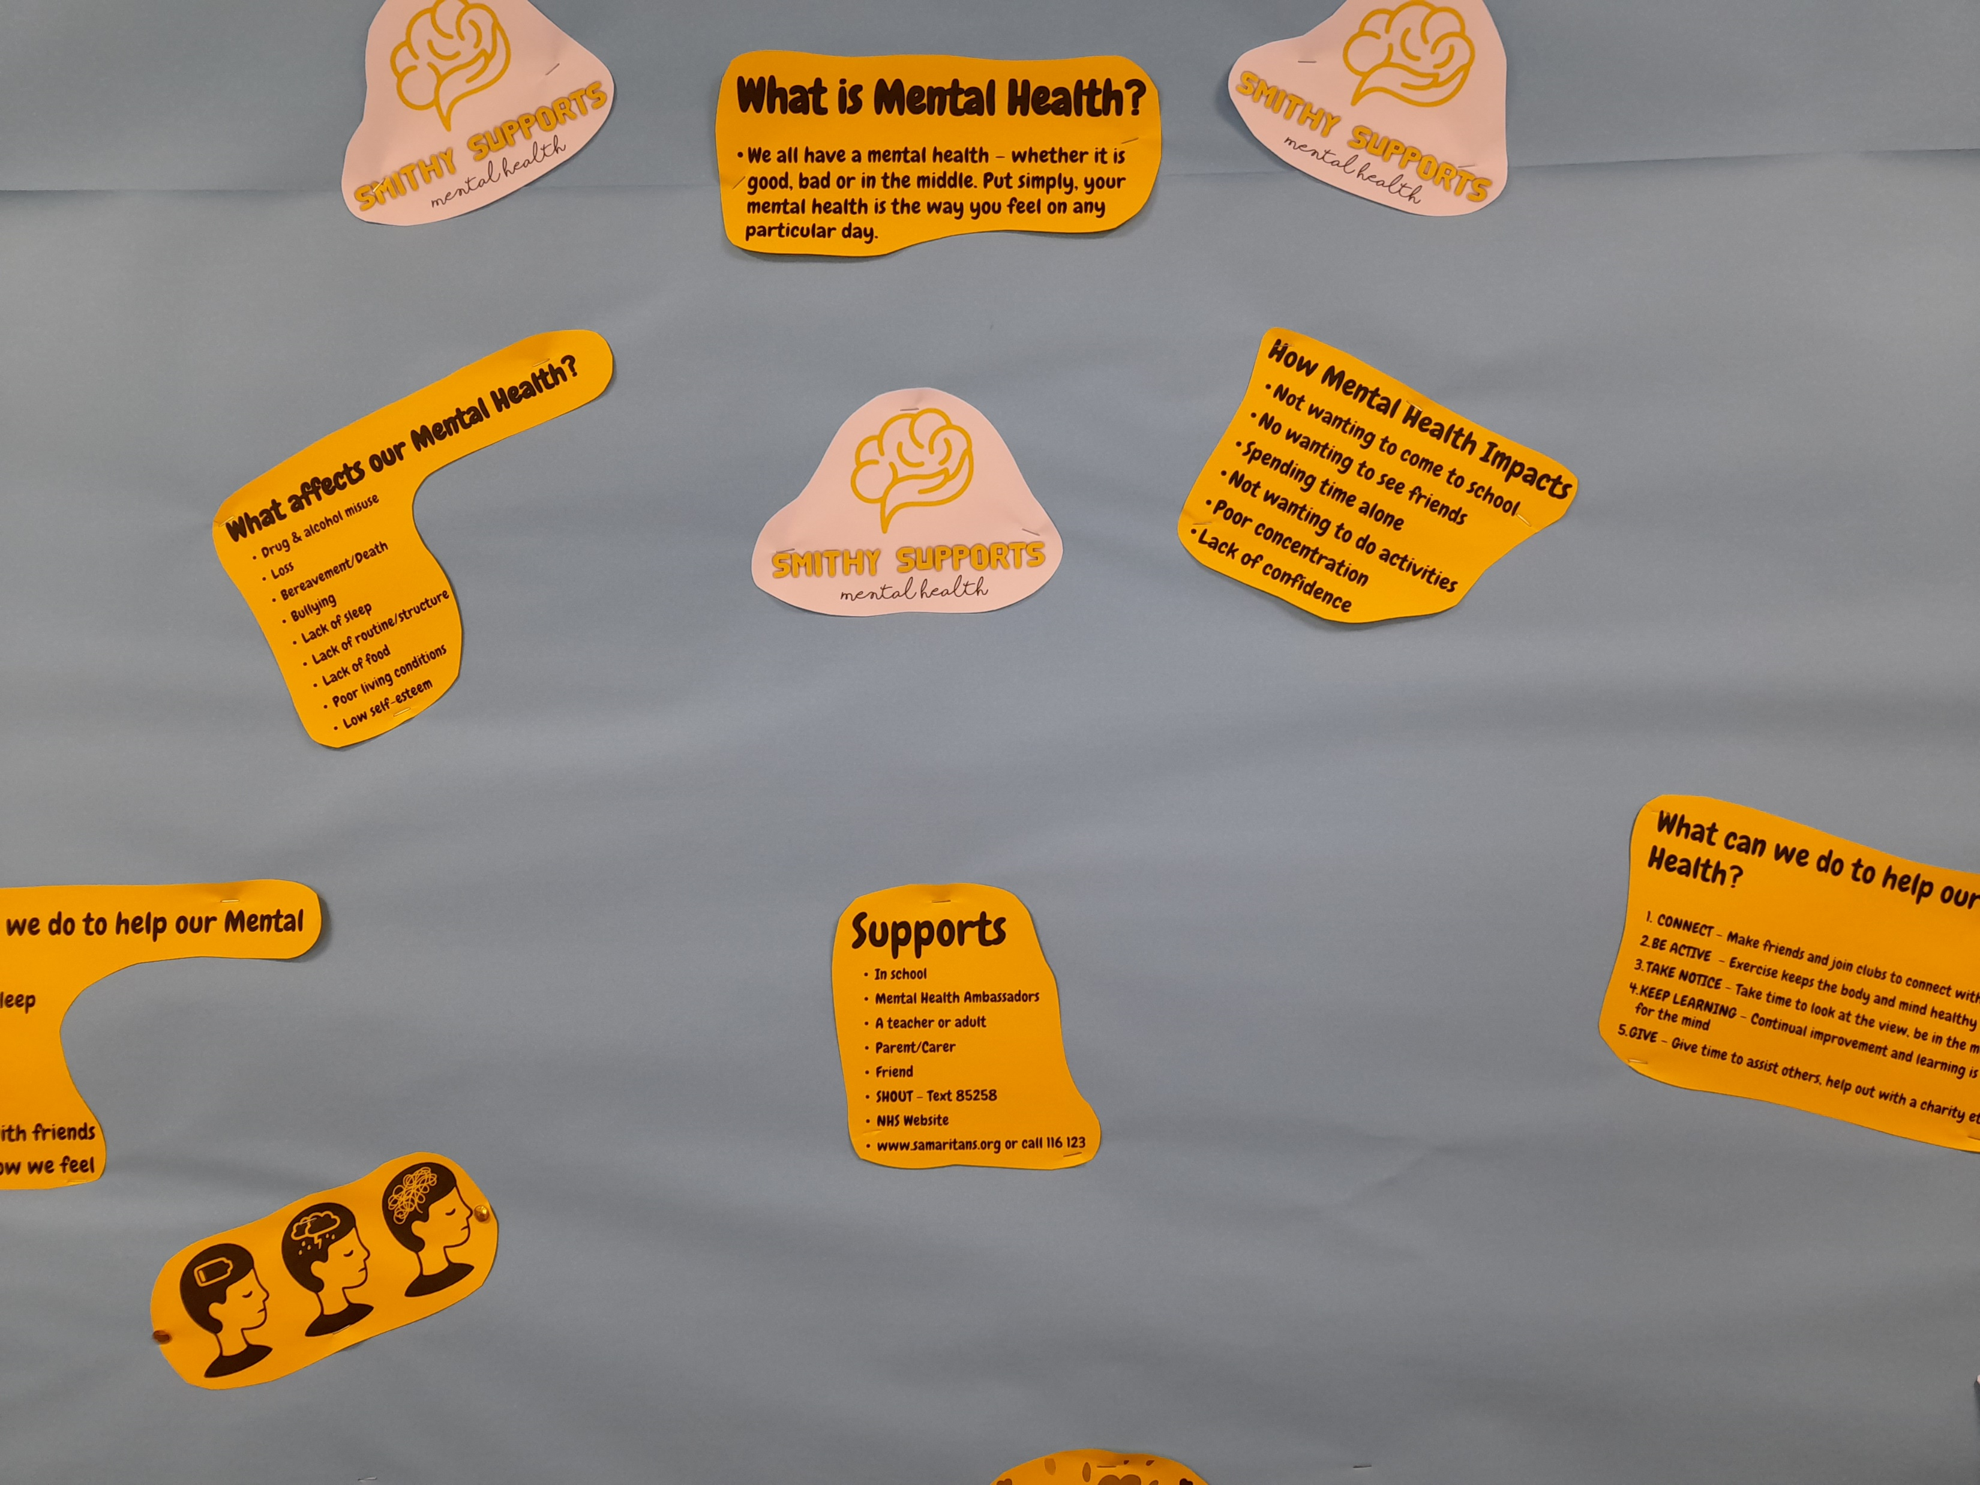
Mental Health Ambassadors
Trained to SCQF Level 5
15 pupils (S4)
To support other young people
First point of contact- alternative option

Slide 10
Minds Matter
Available to whole school
Wednesdays after school 3-4pm
Ran by Natalie Miller
Safe space to offload and get support/guidance
Offer coping strategies and learn about mental health

Slide 11
Parent Learning and Connecting
Date : TBC- will be during the school day (2 hours for seven weeks)
Opportunity for parents to achieve SCQF Level 5 in Mental Health First Aid
Sign up via Google form- will come out via Group Call
Monthly Parent Coffee Morning- first one end of October, date TBC

Slide 12
Clare Smith
Children 1st

Slide 13
Questions?

