Slide 1
New S1 Information Evening
6pm May 17th 2021

Slide 2
This evening’s format
Uniform
#Getreadyforsmithy
Structure of the school day
Curriculum
School meals
Questions

Slide 3
‘We Belong’ - Uniform
Julie Thompson – school support officer

Slide 4
Our Compulsory Uniform:
Blazer £34.00 / £38.00
Tie £4.00
All of our new S1 pupils will be gifted their school tie by our Parent Council.
White school shirt
Black shoes (all black with no colour whatsoever)
Black trousers or black skirt of an appropriate length

Slide 5
Compulsory PE Kit
PE Top (house colour) £10.00 / £11.00
Black shorts, jogging trousers or leggings
Optional:
Smithycroft Hoodie £16.50
Smithycroft Zoodie £18.50
Smithycroft PE leggings with logo £17.00

Slide 6
Blazers / PE Tops / Hoodies / Zoodies:
Our blazer supplier Logoxpres Ltd (Stirling) offer an on-line ordering service for all of our logoed uniform.
They also have a comprehensive sizing guide on their website to allow you to order the correct size blazer for your young person.
If you have any difficulties ordering uniform please get in touch with our school office and we will try to help.

Slide 7
PE Top:
This year by way of welcoming our new S1 pupils to Smithycroft Secondary we will be gifting all of them their PE top.
If you would like to order additional tops you can do so by using the Logoxpres-Schoolwear website.
Remember you need to wait to find out your child’s class as our PE tops are linked to our House system.

Slide 8
#Getreadyforsmithy
We have had lots of wonderful entries from P7’s across our associated primaries and tonight we would like to announce the results.
Entries were judged by familiar faces across our school community including cleaners, kitchen staff, office staff and teaching staff.

Slide 9
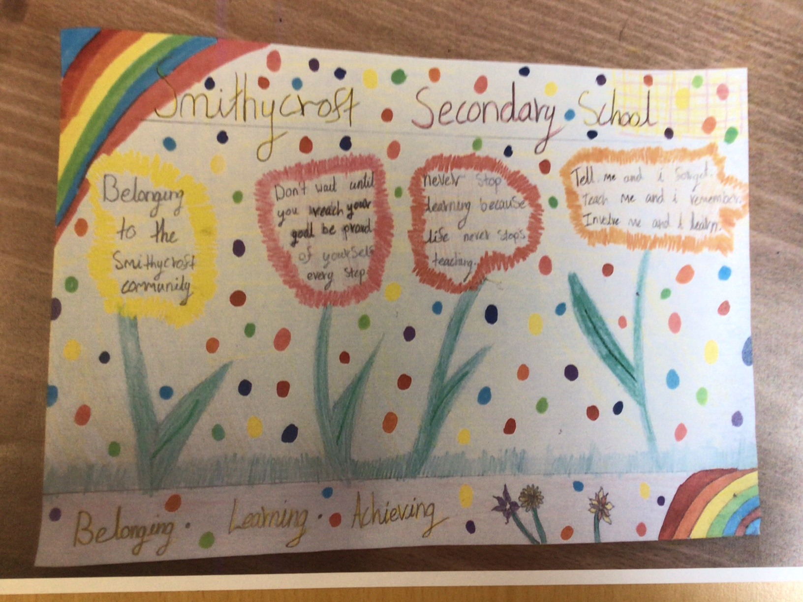

Slide 10
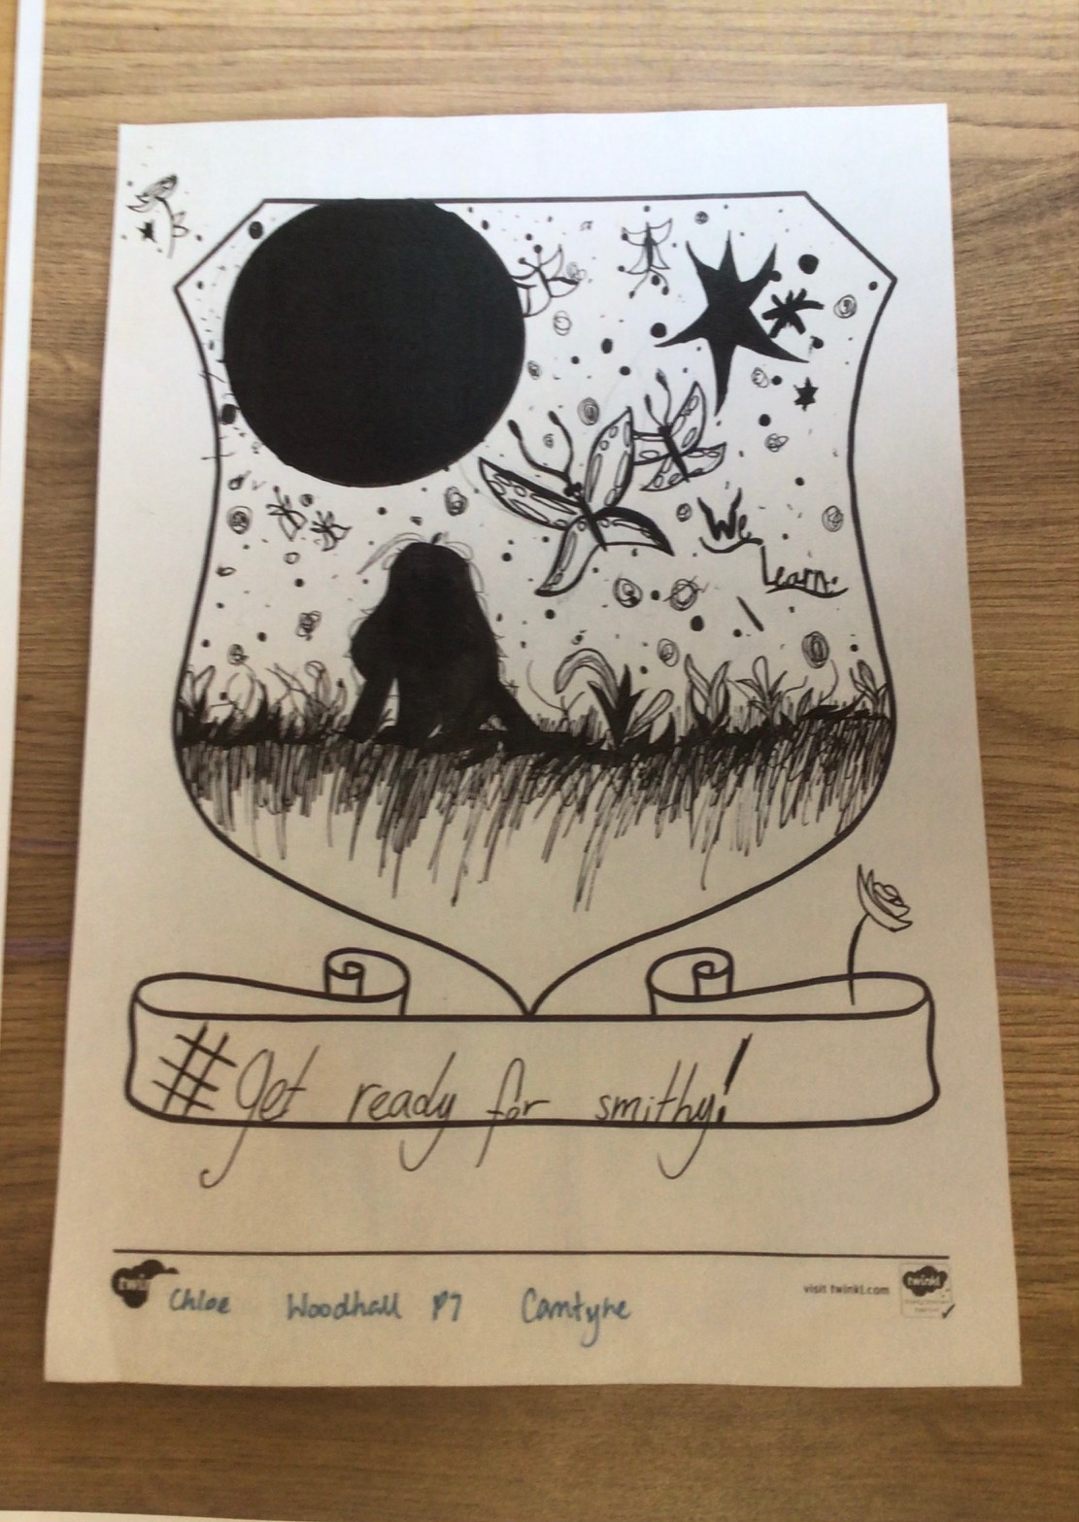
Chloe
Carntyne

Slide 11
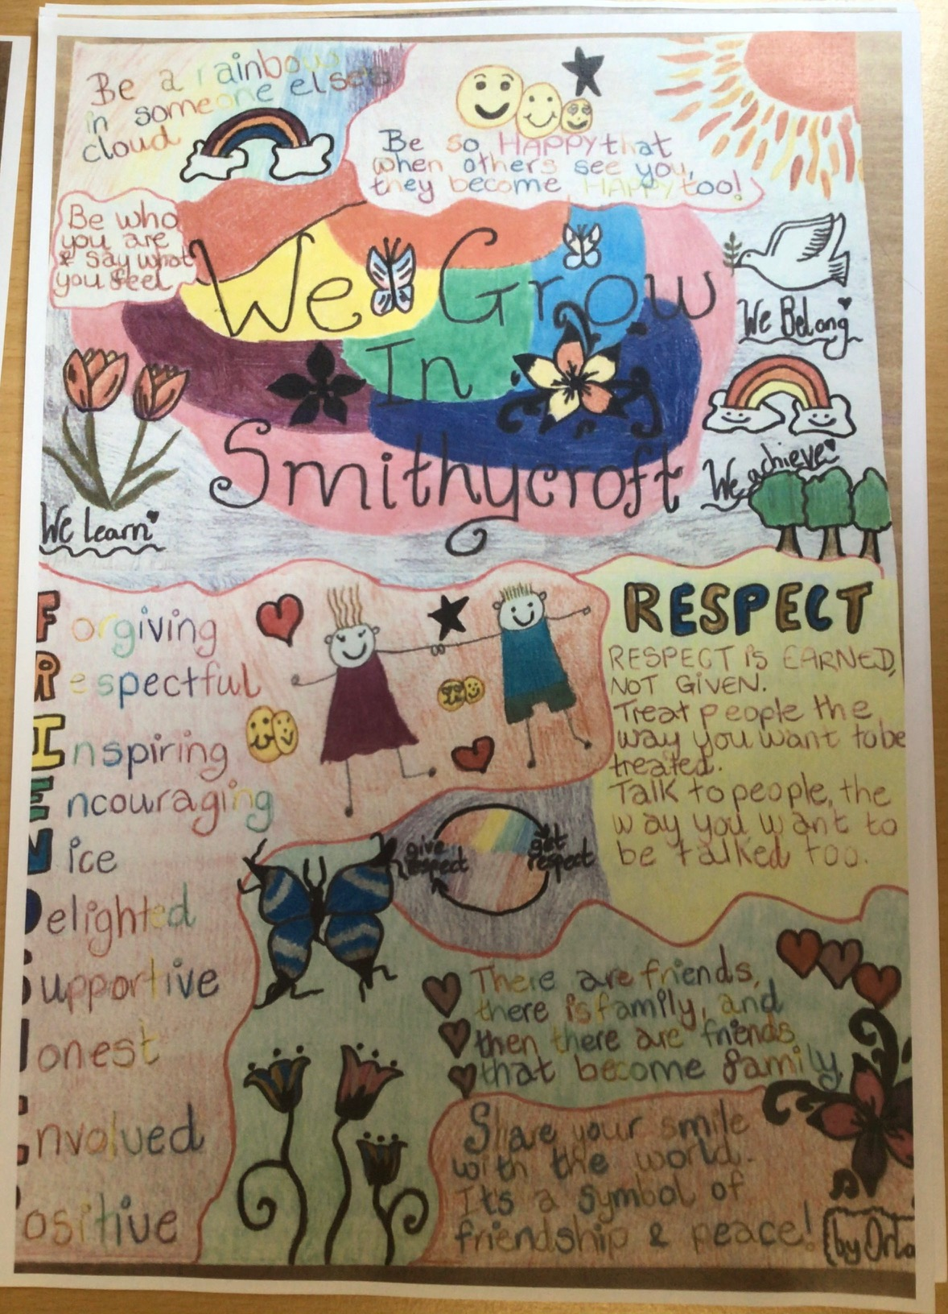
Orlagh
Cranhill

Slide 12
Winner Keir Madden - Avenue End

Slide 13
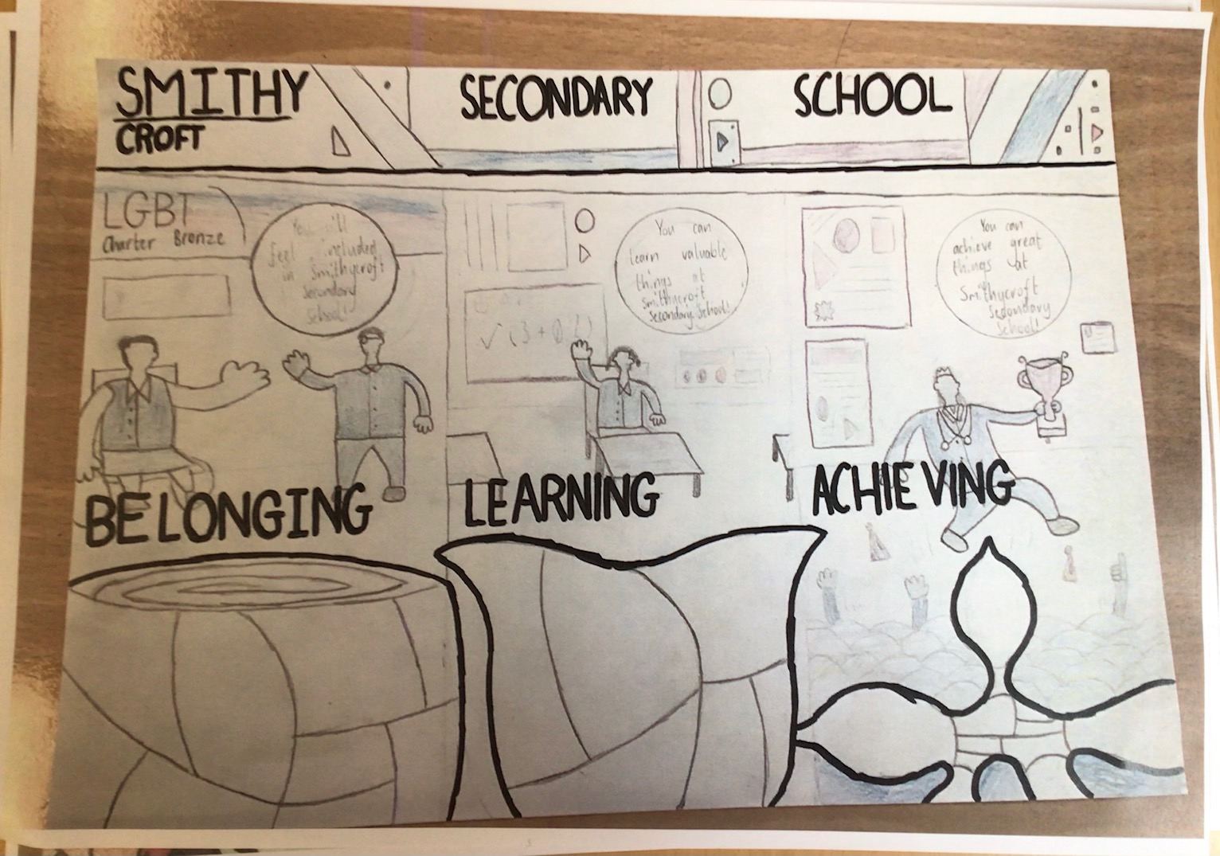

Slide 14
Structure of the school day

Slide 15
Monday and Thursday:
Reg 8.50 – 9.00
P1 9.00 – 9.50
P2 9.50 – 10.40
Int 10.40 – 10.55
P3 10.55 – 11.45
P4 11.45 – 12.35
P5 12.35 – 1.25
Lunch 1.25 – 2.10
P6 2.10 – 3.00
P7 3.00 – 3.50

Slide 16
Tuesday, Wednesday and Thursday:
Reg 8.50 – 9.00
P1 9.00 – 9.50
P2 9.50 – 10.40
Int 10.40 – 10.55
P3 10.55 – 11.45
P4 11.45 – 12.35
Lunch 12.35 – 1.20
P5 1.20 – 2.10
P6 2.10 – 3.00

Slide 17
‘We learn’ – The Curriculum

Slide 18
Curriculum
S1/S2 BGE
Wide range of subjects
Practical subjects
Tracking and reporting
Parents evenings
Timetable

Slide 19
4 x English
4 x Maths
3 x French
3 x Social subjects
3 x Science
2 x PE
2 x Art
2 x Music
2 x Technological Studies

Slide 21
School meals
Cashless system – Parent Pay on the way
Range of healthy options
Interval and lunch options

Slide 22
Questions
Call the school office on 0141 582 0220
Email – Headteacher@smithycroft-sec.sch.uk

Slide 23
Next steps
J12 transition videos and booklet
“About me task” in P7 classes
9th and 16th of June – Activity afternoons
Induction visit to Smithycroft by P7 pupils – hopefully week beginning 21st June

Slide 24
Thank you !
We look forward to meeting you all in person when we can

