Slide 1
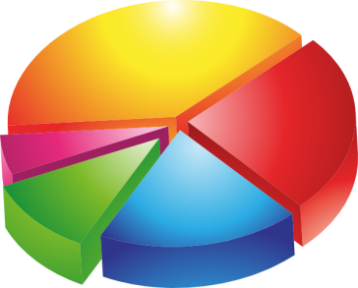
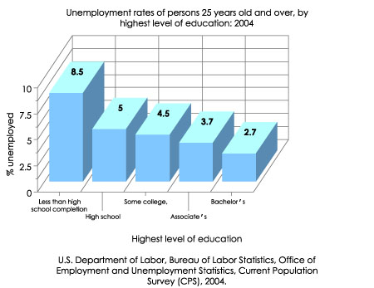
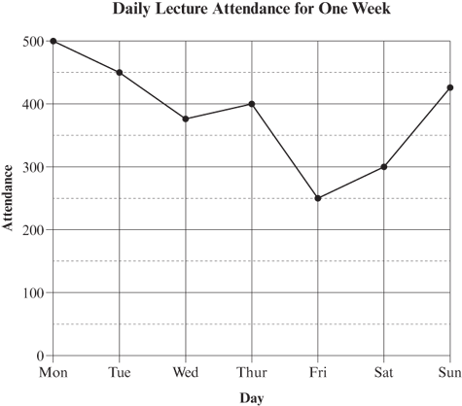
Graphs & Charts

Slide 2
Learning Intentions
You will learn about:
4 main types of graph and chart
Layout Design and planning
What makes a good graph / chart

Slide 3
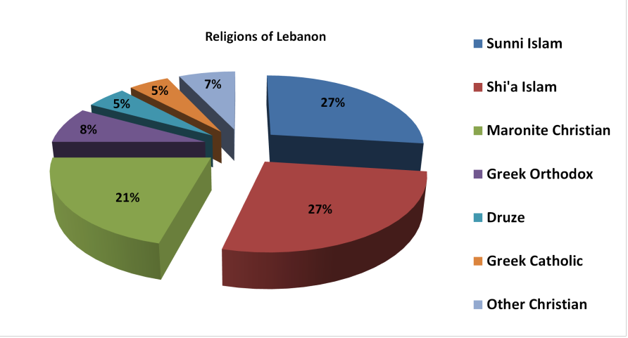
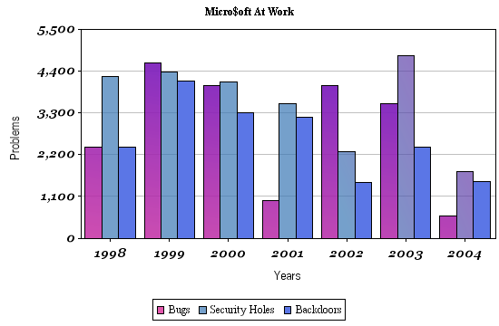
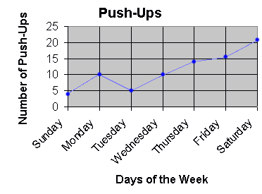
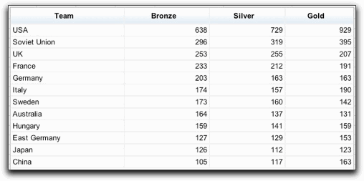
Types of Graph or Chart
Pie Chart
Bar Chart
Line Graph
Table

Slide 4
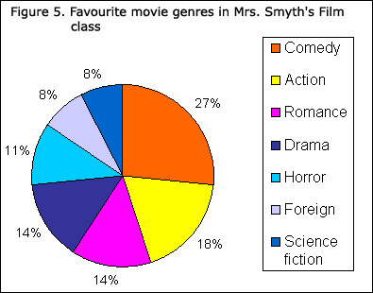
Pie Chart
Circle represents the ‘complete’ or ‘whole’ number.
Each segment represents the whole number.
Do | Do Not
Use when displaying parts of a whole number When results form a solid % | Use when there are too many segments or if some slices become very thin. Use a shape that is too difficult to split up accurately

Slide 5
Bar Chart
Can be a row of bars which show
- how values vary over a period of time.
-how values compare with one another i.e. Male/ female
Do | Do Not
Use when you want to highlight individual figures rather than an overall approach. When comparing different items or figures. | Use when too many bars are required- this makes the chart difficult to follow. Use when the overall flow of the figures is more important than individual values- use a line graph instead.

Slide 6
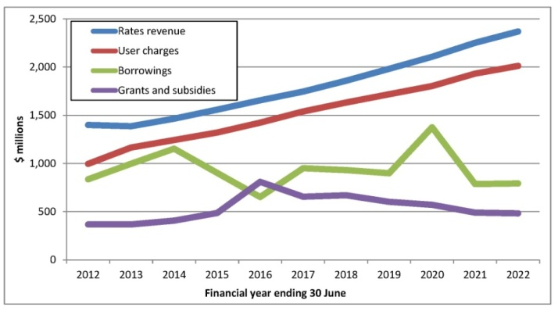
Line Graph
Often used to show quantities plotted over a period of time.
X axis (horizontal) represents time
Y axis (vertical) represents the quantities
Do | Do Not
Use line graphs when its important to show a gradual change in figures over time. | Use line graphs when some quantities are tiny and others are huge- use a table instead.

Slide 7
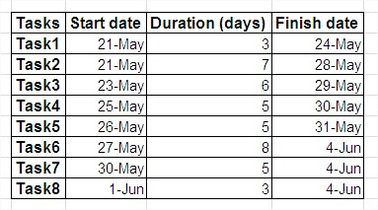
Table
Displays numbers or words in rows and columns
Spreadsheet is a computerised table which can calculate data
Can also produce graphs and charts
Do | Do Not
Use tables when the individual figures rather than the overall flow is most important use tables when comparing numbers that are too far apart to be shown on a chart | Use tables when you can use one of the other three types of chart

Slide 8
Layout Design and Planning
Pages 151- 155 in Course Notes
To achieve a Unit pass at NAT 5 your graph / charts should:
Be the correct type of graph / chart to display the information given
Be graphically enhanced to support the subject matter and connect with target audience- SERIF skills
Be complete- no vital parts missing
demonstrate a high standard of layout

Slide 9
What makes a good Graph / Chart
Pages 151- 155 in Course Notes
A clever and clear title to introduce it
A short note to make the information clear
A graphic to support the subject matter and enhance the layout
A suitable type of graph / chart to display the data or statistics

