Slide 1
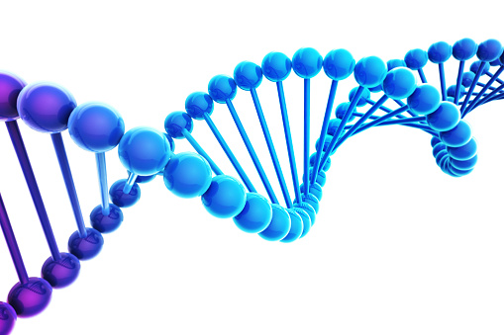
National 5 Biology Unit 1 – Cell Biology
Section 8 – Controversial Biological Procedures

Slide 2
We will be learning to…
Describe what a controversial biological procedure is
Give examples of controversial biological procedures
Describe what gene therapy is
State why gene therapy is controversial
Describe what pharming is
State why pharming is controversial
Describe what transgenic animals and plant are
State why transgenic animals and plants are controversial
Investigate a controversial biological procedure of your choice

Slide 3
What are Controversial Biological Procedure?
Since the 1980’s, advances in scientific knowledge and techniques and increasing computing power, coupled with decreasing analysis costs, have made possible biological procedures that only a few decades ago would have been classed as science fiction.
Some of these procedures have made headlines in the newspapers and television and have not always been universally welcomed by the public.
Cloning

Slide 4
Examples of Biological Procedures
Genetic Engineering
Gene Therapy
Pharming
Cloning
Genetically Modified Food
Transgenic Plants
Transgenic Animals

Slide 5
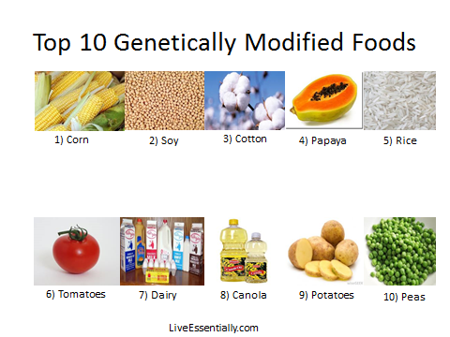
What is Genetically Modified Food?
The first controversial procedure to really grab the public’s attention was genetically modified foods or GM foods, also called food from Genetically Modified Organisms or GMO. The main reason is for resistance to herbicides (weedkillers).

Slide 7
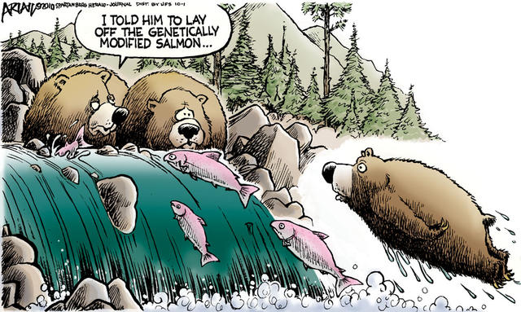
GM Food. Good or Bad?
The media compared this to creating the Frankenstein monster and called the early modified plants “Frankenfoods” and implied that scientists were “playing God” and interfering with nature.
This created unease among the public and GM foods were removed from sale in Europe but not in the USA where agribusiness has more political power and influence.

Slide 8
Cloning
Dolly was a female domestic sheep, and the first mammal cloned from an adult somatic cell, using the process of nuclear transfer.
Dolly was euthanised because she had a progressive lung disease and severe arthritis. A Finn Dorset such as Dolly has a life expectancy of around 11 to 12 years, but Dolly lived 6.5 years
https://www.youtube.com/watch?v=tELZEPcgKkE

Slide 9
What is Gene Therapy?
Gene therapy is the treatment of disease by the transfer of genetic material (DNA) from one individual to another.
This has the potential to cure genetic diseases like cystic fibrosis.
Problems include: getting the gene into the target tissue, e.g. the lungs and getting the gene switched on once in the target cells.

Slide 10
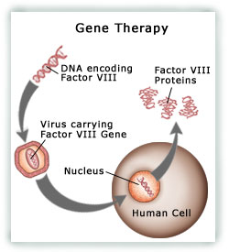
Use of Gene Therapy
Gene therapy has had limited success so far and current research is aimed mainly at cancer treatment.

Slide 11
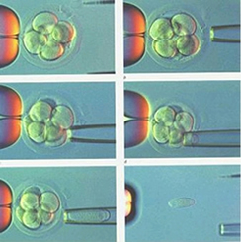
Embryo Screening and Treatment
Treatment of eggs/sperm or pre-implantation embryos to cure diseases before the baby grows is another controversial area.
Removal of cell from pre-implantation embryo

Slide 12
Why is Gene Therapy Controversial
Advantages | Disadvantages
Can be used to “silence” a disease before it’s onset e.g. HIV and AIDS | Short lived so you need repeated therapy
Potential to stop and prevent hereditary diseases | Viral vectors might trigger an extreme immune response
Achieving pharmacological effects e.g. making cancer cells susceptible to anticancer drugs | Virus could target the wrong cell → new disease
Last chance therapy | Difficult to effectively treat multigenic disorders e.g. diabetes

Slide 13
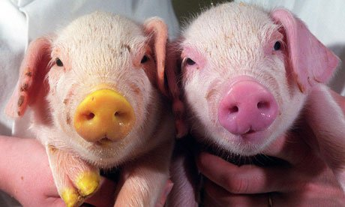
What is Pharming?
Pharming is a new development where animals or plants are genetically engineered to produce proteins with medical uses.
The protein can be delivered to the body by eating the plant or by purifying the protein from milk.
This process could potentially be cheaper than growing conventional genetically engineered microbes by about 70%.
https://www.youtube.com/watch?v=B0zT9CN3-50

Slide 14
Uses of Pharming
Insulin for diabetes
Various vaccines for hepatitis, cholera, flu etc.
Anti-clotting agents for heart attacks
β - Carotene enhanced rice to treat night blindness (Golden rice)

Slide 15
Why is Pharming Controversial?
Advantages | Disadvantages
Plants producing the edible vaccines could be grown in the third world countries | Plants are living organisms that change, so the vaccine production might not be guaranteed.
Plants are regularly used in pharmaceuticals, and there exist established purification protocols | The edible vaccines could be mistaken for regular fruits and consumed in larger amounts than might be safe
Growing plants is much cheaper than producing vaccines | The dosage of the vaccines might be variable. For example, different sized bananas will contain different amounts of vaccine.
Plants can not host most human pathogens, so the vaccines will not pose a danger to humans | If the vaccines were grown in fields or on trees, security would become a big issue.

Slide 16
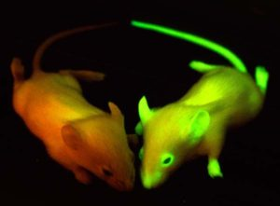
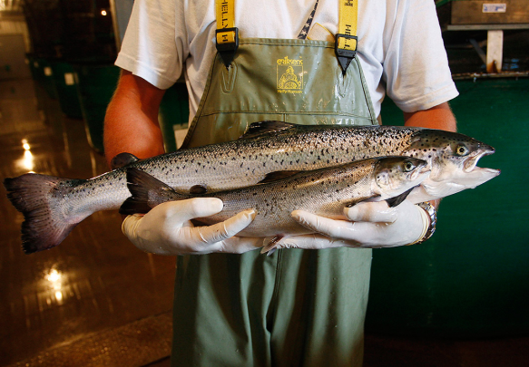
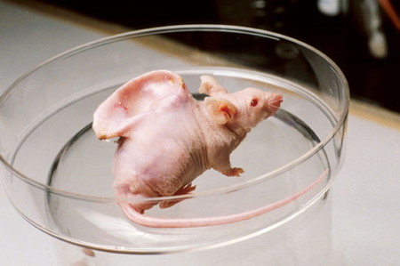
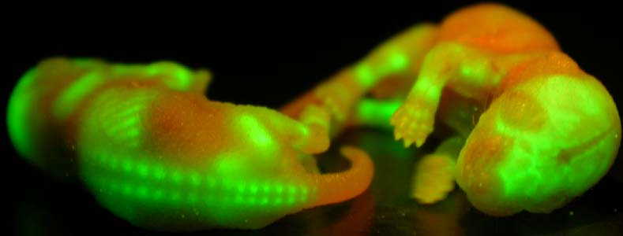
What are Transgenic Animals and Plants?
GMOs, also called transgenic animals and plants, are living organisms that have DNA inserted from another organism.
This DNA may give the recipient organism resistance to disease, make it more tolerant to drought, may make it grow bigger, take longer to go off once picked, or any number of different properties.

Slide 17
Why are Transgenic Animals and Plants Controversial?
Advantages | Disadvantages
Contains extra genetic material integrated into the genome in every cell | Transgene integration is apparently random e.g. its not always successful
Generated to carry cloned genes to provide a good model for human cancer | The gene is not consistently expressed
 | This is an expensive and labour intensive process

Slide 18
Success Criteria
I can describe what a controversial biological procedure is
I can give examples of controversial biological procedures
I can describe what gene therapy is
I can state why gene therapy is controversial
I can describe what pharming is
I can state why pharming is controversial
I can describe what transgenic animals and plant are
I can state why transgenic animals and plants are controversial
I can investigate a controversial biological procedure of your choice
By the end of this section you should be able to:

Slide 19
Word | Definition
Transgenic animal | An animal with a foreign gene deliberately inserted into their genome
Transgenic plant | A plant a foreign gene deliberately inserted into their genome
Ethics | moral principles that govern a person's behaviour
Pharming | scientists alter an animal's own DNA, or to splice in new DNA, called a transgene, from another species
Genetics | a branch of biology concerned with the study of genes, genetic variation, and heredity in organisms.
Gene | functional unit of heredity. Genes are made up of DNA. Some genes act as instructions to make molecules called proteins
Gene therapy | an experimental technique that uses genes to treat or prevent disease.
Cloning | To produce a genetically identical organism
GM Foods | foods produced from organisms that have had changes introduced into their DNA using the methods of genetic engineering.
GMO | any organism whose genetic material has been altered using genetic engineering techniques.

Slide 20
Revision Questions

Slide 21
Jobs slide
Geneticist
Microbiologist
Nanobiologist

