Slide 1
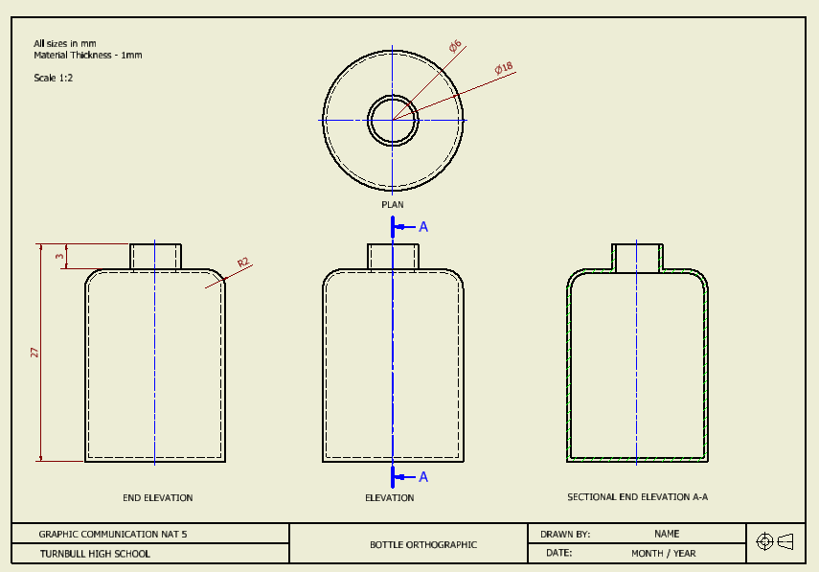
LABEL
Each of your views should be labelled appropriately. Each label should be in capital letters and should be centred under each view.

Slide 2
DRAWING TITLE
Your drawing should be named appropriately to describe what the drawing is showing e.g. Assembled orthographic, exploded isometric etc.
NAME AND DATE
You should include your name and when the drawing was produced.
3RD ANGLE PROJECTION SYMBOL
This is only necessary when you have drawn an orthographic drawing to show which way the views are projected.

Slide 3
RADIUS
The radius symbol should only be used when dimensioning curves and arcs. It should never be used for dimensioning a complete circle.
DIAMETER
The diameter symbol should be used when dimensioning full circles.
DIMENSION ORDERING
Larger dimensions should be placed further away from the object while smaller dimensions should be placed closer to the object.

Slide 4
Centre Lines
Centre lines are not automatically added in Inventor so you must add them yourself.

Slide 5
ADDITIONAL INFO
Additional information such as the thickness of the material (if applicable) and the scale of the drawing should be added to the page.

