Slide 1
How did Hitler keep control?
PROPAGANDA

Slide 2
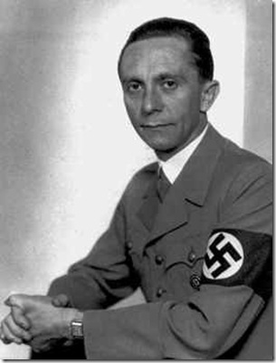
Josef Goebbels
Goebbels gave the order in 1938 for Kristallnacht.
He took control over the mass media.
Newspapers and posters were monitored very closely and were issued with strong and simple slogans about the Nazis.
The policy of censorship allowed Goebbels to control the media and ensure Germans never heard conflicting messages.
Centre of propaganda network, which Hitler laid out in his book Mein Kampf
Joined the Nazi party in 1922, first opposing Hitler, but later supported him.
He had a limp due to suffering from polio, however he told people it was due to a war injury.
Goebbels was a journalist, Hitler was impressed with his writings.
In 1928 he was appointed head of Nazi Ministry of Propaganda.

Slide 3
Role of the Newspapers
All anti – Nazi papers were shut down.
Jews were banned from owning or working for newspapers.
Daily instructions sent out to newspapers telling them what to print, what pictures to show and what stance they should take.
Newspapers were posted on display boards in order for all to be able to read.

Slide 4
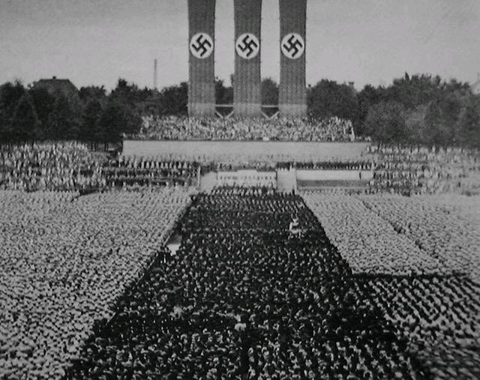
The role of Rallies
Control and order was a very important image that the Nazis wanted to portray.
Rallies helped them to present this image.
A huge stadium in Nuremberg was built for this purpose.
Goebbels stage managed these rallies to give a dramatic impression of overwhelming power and unity.

Slide 5
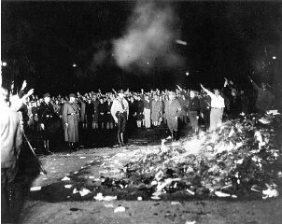
The Role of Books
All books had to be censored by the Nazis.
The Nazis were worried about independent thinking.
Official book – burnings were common place to rid Germany of books published by...
      Communist and Socialist
      Jews
      Anyone they disapproved of
      Or containing ideas they disapproved of.

Slide 6
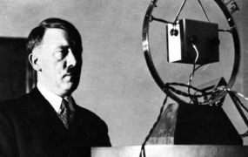
The role of Radio
Goebbels was placed in charge of all radio broadcasts.
There was a block on all foreign programmes.
Radio programmes would include Hitler’s speeches, German history and music.
Cheap radios were made to enable as many Germans as possible to listen to the propaganda.
By 1939 70% of Germans owned a radio.
Loud speakers were set up in public squares.

Slide 7
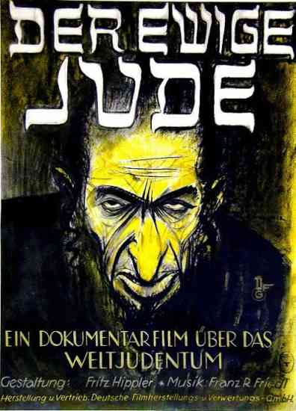
The Role of Films
Goebbels controlled all the films made in Germany.
Newsreels were made by Goebbels film makers and shown before every film.
Goebbels ordered some openly pro-Nazi films to be made where he had strict control over the scripts, E.g The Eternal Jew (poster above)

Slide 8
Which form of POPAGANDA was the most important and effective?

