Slide 1
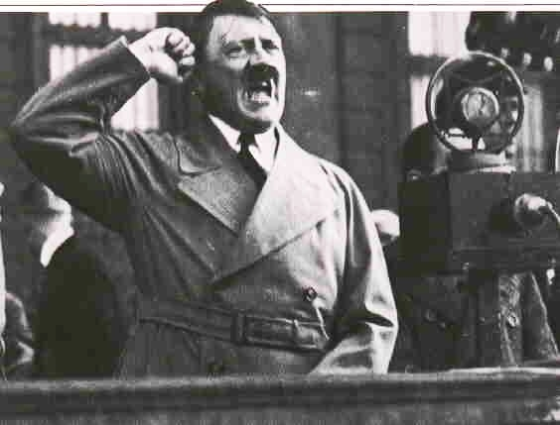
N = Nazi Party
HITLER
(PERSONALITY)
FAILURE OF WEIMAR’S LEADERS
NAZI PROMISES
FEAR
NAZI PROPAGANDA

Slide 2
The final factor that brought Hitler to power was the failure of the Weimar leaders in the Reichstag between 1928 and 1933…
FAILURE OF WEIMAR’S LEADERS
BETWEEN 1923 AND 1928 THERE WERE NO ELECTIONS, STRESEMANN HAD BEEN POPULAR.
BETWEEN 1928 AND 1933 THERE WERE 4 ELECTIONS.

Slide 3
EXTREME TIMES CALL FOR EXTREME MEASURES
Germany in 1931
5 million wage earners out of work;
Middle classes facing ruin;
Farmers unable to pay mortgages;
Parliament paralysed;
Government floundering;
President Hindenburg increasingly senile.

Slide 4
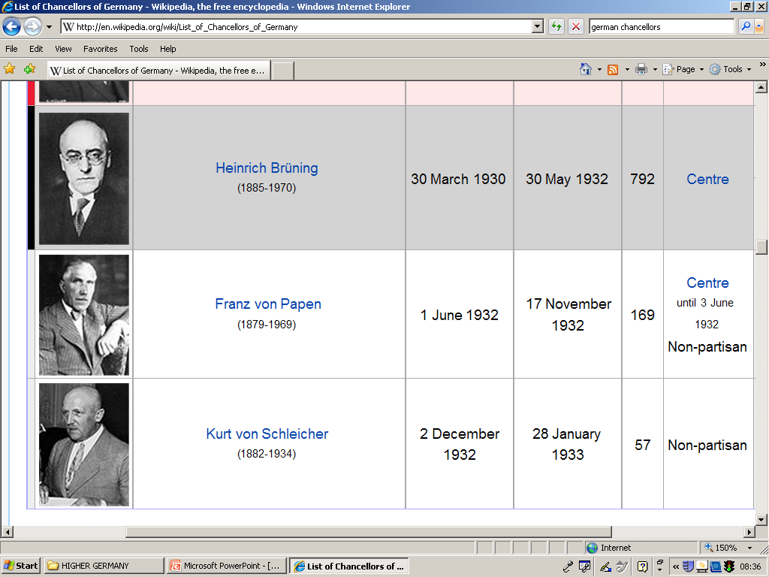
German Chancellors 1930 - 1933

Slide 5
Failure of Weimar’s leaders
Weimar politicians played a part in their own downfall.
President Hindenburg, Franz von Papen, and General von Schleicher were the main culprits as they seemed more concerned with their own positions and restoring order rather than maintaining democracy.
The three men thought Hitler could be controlled and used as a political pawn.

Slide 6
Weimar Government in Decline
30th May 1932 – Bruning resigns after two years of minority government, ruling with the help of Presidential emergency decrees.
Papen becomes Chancellor, governing with the support of Hitler
After the July elections the Nazis overtake the SPD; at the same time Schleicher convinces Hindenburg to appoint him as Chancellor – replacing Papen

Slide 7
Nazi propaganda
By 1932 the Nazis had become a force to be reckoned with;
Hitler felt powerful enough to challenge Hindenburg for the Presidency.
PRESIDENTIAL ELECTION RESULTS APRIL 1932, HITLER VERSUS HINDENBURG
HINDENBURG VOTES: 19.4 million
HITLER VOTES: 13.4 million
Elections of July 1932 Nazis achieved 37.3% of the vote, more than any other party;
It was clear government could not run without cooperation of the Nazis…

Slide 8
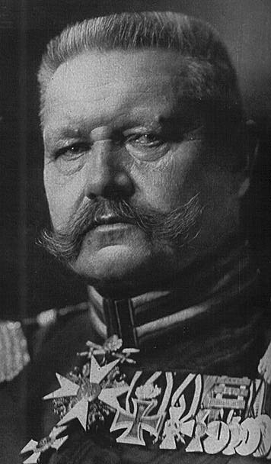
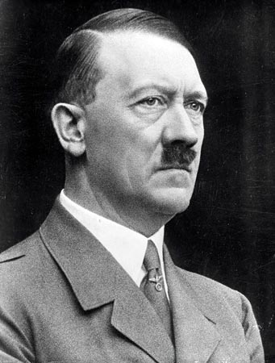
In November 1932 Von Papen asked Hitler to become Chancellor, with Papen as vice-Chancellor;
Hitler accepted and on 30th January 1933 was sworn in as Chancellor.
Papen had persuaded Hindenburg that they could control Hitler by giving him what he wanted…

Slide 9
A note on Nazi Support
Big business and industrialists began to realise that Hitler, who they had initially viewed as an “AUSTRIAN UPSTART” could perhaps one day control Germany.
They MISTAKENLY thought that by throwing large amounts of money at him that he would do their bidding once he achieved power.

Slide 10
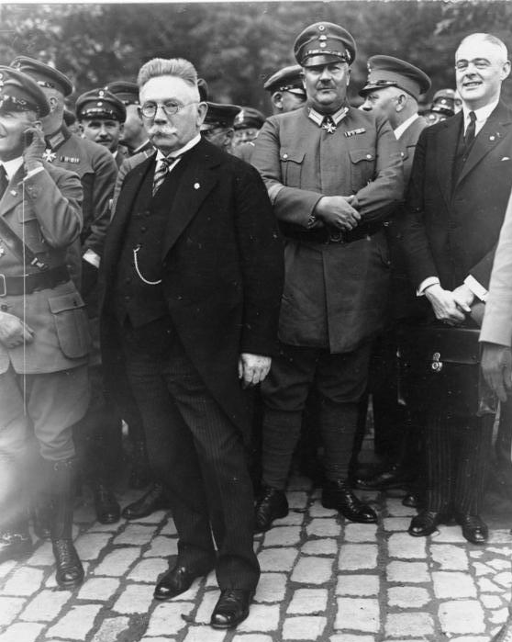
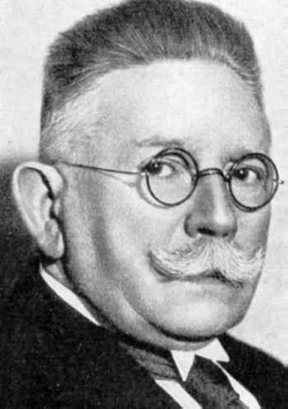
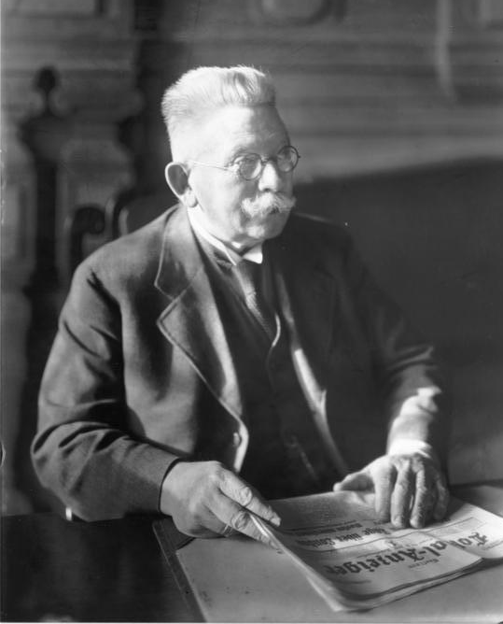
Alfred Hugenberg (Leader of the German People’s Party (DNVP))
Owned most of Germany’s new cinema industry!!!
Owned many local newspapers.

Slide 11
We have looked at the weaknesses and problems of the Weimar Republic, now we must focus on the appeal of the Nazi Party themselves…

Slide 12
Hitler: The Leader
Hitler represented strong leadership in contrast to the politicians of the Weimar Republic
Oral skills – ‘He was the Nazi Party’s greatest electoral asset.’
Hypnotic effect – Hitler was an incredibly charismatic speaker who could whip audiences into a frenzy with his emotional delivery and vague promises of a greater Germany.

Slide 13
Travelled widely to spread the Nazi message - saw the value of effective propaganda
He was also responsible for the highly-popular, vote-catching policies of the Party which guaranteed them the support of a wide section of the population

Slide 14
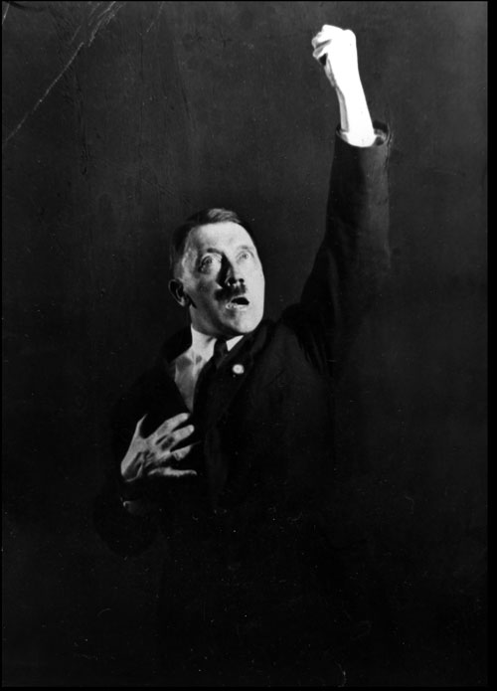
http://www.youtube.com/watch?v=_Q-6H4xOUrs

Slide 15
Nazi Policies
The Nazi policies were very important in gaining support from the public. Many of their ideas were vague, as they tried to be ‘all things to all men’
Nazi Policies:
The promise of jobs was a major vote-winner with the Working Class, and with younger voters
A safe alternative to communism (a very real threat at the time) won the support of big business and the middle classes – the Nazis also promised to curb the power of trade unions

Slide 16
Two further policies proved popular with almost all sections in German society.
NATIONALISM: They promised to destroy the hated Treaty of Versailles and restore Germany to its former glory. This idea of German supremacy hinged on the ‘master race’ theory of Social Darwinism
ANTI-SEMITISM: This had a history in Germany and provided Germans with a scapegoat for all of their troubles

Slide 17
Nazi Propaganda
A Ministry of Propaganda was established by the Nazis and led by Joseph Goebbels
This shows the importance they placed on playing on the fear of people and getting their message across
They exploited the new media of cinema and radio. Hitler became closely associated with the media tycoon Hugenberg
Hitler often flew to cities all over Germany to speak – their campaigns were very efficient
Rothnie: “Never has any party prepared for power more thoroughly than the Nazis.”

Slide 18
1932, Nazis launch biggest propaganda campaign Germany had ever seen:
Hitler flew across Germany in a JUNKERS TRANSPORT PLANE holding up to 4 huge rallies in up to 4 major cities a day.
1 million coloured posters;
8 million pamphlets;
12 million extra copies of party newspapers;
3,000 meetings a day across Germany;
First time EVER in German election history that FILM and GRAMAPHONE records had been used.

