Slide 1
5. Scottish Battles of WWI

Slide 2
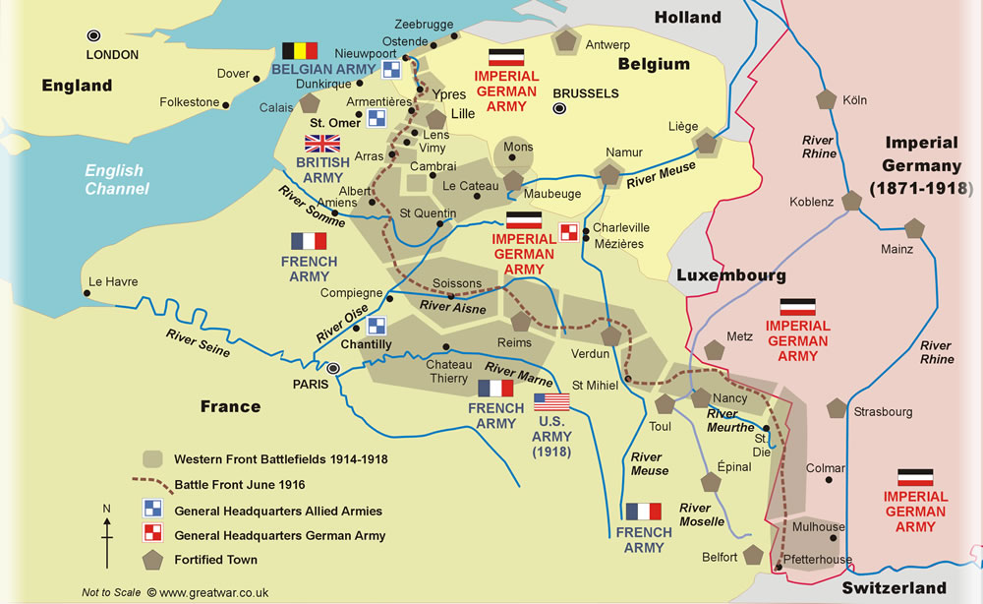
Loos

Slide 3
The Battle of Loos
Historian, John Kerr, describes Loos as ‘a Scottish battlefield’.
Over 30,000 Scottish soldiers fought at Loos
1/3 of the 21,000 soldiers who died were from Scottish regiments
Of the 950 men of the 6th Cameronians regiment, 700 were killed or injured
No part of Scotland was unaffected by the losses

Slide 4
Doomed to fail?
General Haig was worried about the flat, open landscape of the battlefield – an attack would easily be seen by the Germans
Haig also worried about lack of artillery and use of new Kitchener’s volunteer army – they were not experienced. Gas was used to make up for lack of artillery.
Lord Kitchener overruled Haig and the attack went ahead.

Slide 5
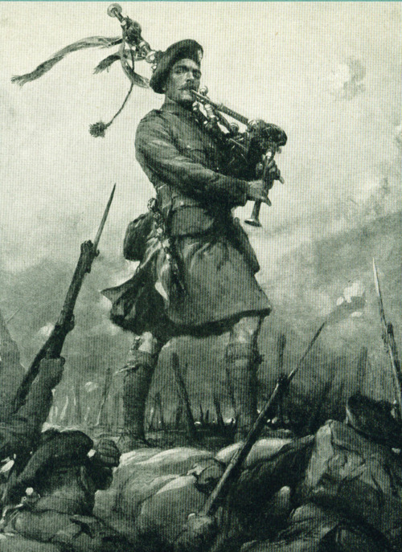
The ‘Piper of Loos’
After the initial 4 day bombardment troops went ‘ower the bags’
A piper called Laidlaw began playing Scottish tunes on the bagpipes
He continued even though injured by shrapnel
He got one of the five Victoria Cross bravery medals awarded to Scottish soldiers after the battle

Slide 6
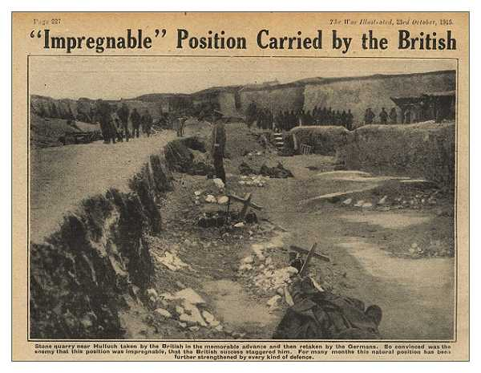
Scottish regiments reached German front line but effective reinforcements were not sent so the advantage was lost

Slide 7
Scottish determination
Despite the loss, Scottish troops were even more determined to fight on
They gained a reputation as aggressive troops who were to be feared by the enemy
A lieutenant in the Black Watch said,
‘Another of our warriors had a German in each hand, gripping them by their chests, dragging them along and butting them in the face with his head, having apparently lost his rifle.’

Slide 8
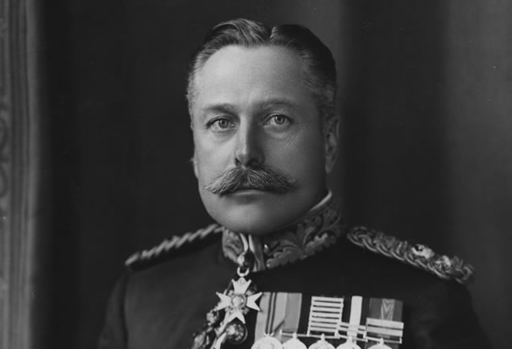
The Battle of the Somme
General Douglas Haig was the Scottish commander-in-chief. He was in charge of the Battle of the Somme.

Slide 9
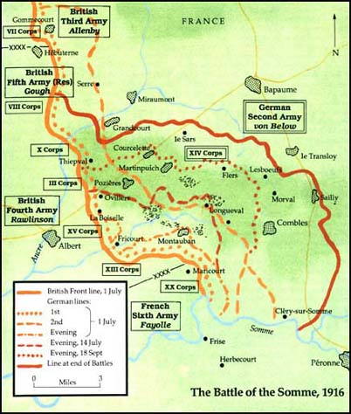

Slide 10
The Battle of the Somme
One week bombardment of German trenches by over 1000 guns
British soldiers went ‘over the top’ at 7.30am on 1st July 1916
Well-prepared and protected Germans emerged from deep dugouts to man machine gun posts
5 miles gained by British by end of fighting in November. Over 1 million casualties on all sides.

Slide 11
Why was the British attack so difficult?
Germans had strong defences and deep dugouts and were situated uphill
German machine gun posts were manned immediately after the British bombardment stopped – the bombardment had warned the Germans that an attack was coming
Some of the artillery shells failed to explode, and they did not cut through the German wire effectively

Slide 12
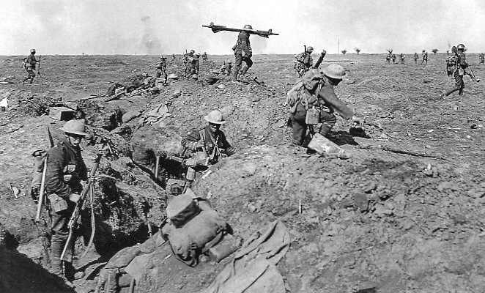
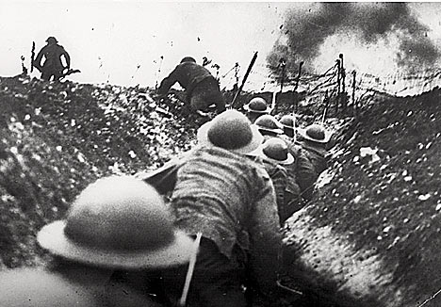
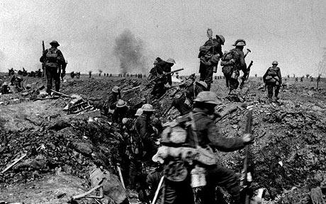

Slide 13
Scottish Soldiers on the Somme
3 Scottish divisions took part
51st Highland division suffered 3500 casualties
Pals Battalions – more than 500 soldiers in the 16th battalion were ex-Boy’s Brigade members from the same area of Glasgow. Their deaths devastated their close community.

Slide 14
The Battle of the Somme: Tasks
Web-based task to find out what happened on the ‘blackest day of British military history’.
‘Lions led by donkeys’ - Group task. Your group will discuss the competence of British military commanders at the Battle of the Somme.
Notes:
The instructions for the web-based task and the Somme group task are in separate word documents.

