Slide 1
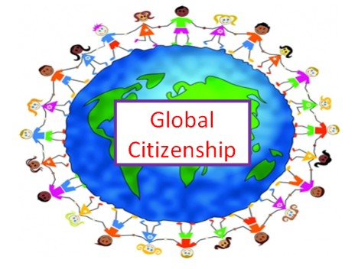
Global Citizenship
Chantelle Burns & Gabrielle Brown

Slide 2
What does this mean ?
A Global Citizen is someone who understands the wider world and their place in it.
They take an active role in their community and work with others to make our planet more equal and fair.

Slide 3
Why is it important?
We need to create a global understanding of what is happening everywhere in the world.
This means we can create lists of human rights. These help protect everyone in the world.
When we learn about each other and look after one another, we are Global Citizens and we all become healthier, happier and more successful.

Slide 4
What could we do?
This video shows how we take things for granted.
Once you learn about issues in the world it makes you want to help others.
We are thinking about what we can do at Smithycroft to become Global Citizens.
Tell us anything you can think of that would make the world a better place.

